Slide 1
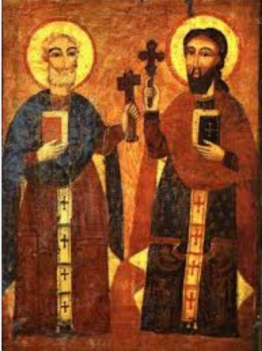
St Bede’s Catholic School
Daily Reflections and Prayers
Theme – St Peter and Paul
26th June - 30th June 2023
The liturgical colour is GREEN
We are in the ORDINARY Time

Slide 2
Mission Statement
With the Lord’s help, we are united in faith, we strive for success and excellence, we are determined to be the best that we can be.
Faith ~ Excellence ~ Determination

Slide 3
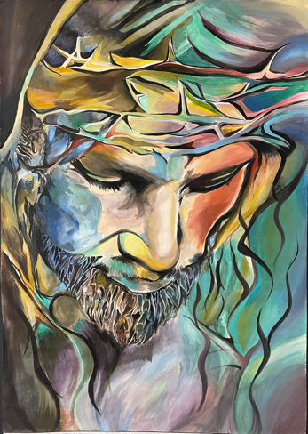
Monday 26th June 2023

Slide 4
Morning Prayer
O holy Apostles Peter and Paul,
Intercede for us.
Protect O Lord your people who trust in the
patronage of your apostles, Peter and Paul.
And by their constant protection,
Protect you people.
Through Christ Our Lord.
Amen

Slide 5
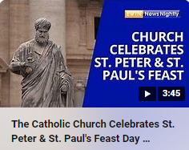
St Peter and Paul
Thursday the 29th June is the Feast Day of St Peter and St Paul.
St. Peter and St. Paul were very different people. They each had an important mission for building up the early Church, and the way each saint served God and spread the Gospel was unique to the special gifts God gave him. But in many ways, St. Peter and St. Paul were quite alike. After reaching drastically low points (for Peter, denying Jesus; for Paul, persecuting the early Christians), both men decided to say yes to God. And their “Yes” changed everything for the early Church, leading to the Church we have today.
The feast day of St. Peter and Paul is celebrated together as it is the day that honours the martyrdom of the two saints, sometime between AD 64 and 68. While the church recognizes that they may not have died on the same day, tradition says that this is the day that they were both martyred in Rome by Emperor Nero.
Bing Videos

Slide 6
In nomine Patris, et Filli et Spiritus Sancti. Amen
End of Day Prayer
Good Jesus,
by your loving kindness,
enable me to come to you,
the fountain of wisdom,
and to stand forever before your face,
Amen
St Bede: Pray for Us
https://www.youtube.com/watch?v=YAcokfQ3cqY

Slide 7
Tuesday 27th June 2023

Slide 8
Morning Prayer – Gloria
Glory to God in the highest. And on earth peace to men of good will. We praise You. We bless You. We adore you. We glorify You. We give You thanks for Your great glory.
O Lord God, heavenly King, God the Father almighty. O Lord Jesus Christ, the Only-begotten Son. O Lord God, Lamb of God, Son of the Father: you Who take away the sins of the world, have mercy on us.
You Who take away the sins of the world, receive our prayer. You Who sit at the right hand of the Father, have mercy on us.
For you alone are holy. You alone are the Lord. You alone, O Jesus Christ, are most high. Together with the Holy Spirit in the glory of God the Father.
Amen.

Slide 9
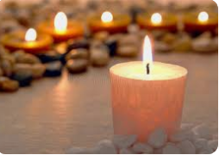
Domino Adiuvante
Reading/Assembly Day

Slide 10
In nomine Patris, et Filli et Spiritus Sancti. Amen
End of Day Prayer
Good Jesus,
by your loving kindness,
enable me to come to you,
the fountain of wisdom,
and to stand forever before your face,
Amen
St Bede: Pray for Us
https://www.youtube.com/watch?v=YAcokfQ3cqY

Slide 11
Wednesday 28th June 2023

Slide 12
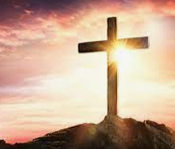
Morning Prayer – The Lord’s Prayer
Our Father
Who art in Heaven
Hallowed be Thy name;
Thy Kingdom come,
Thy will be done
On earth as it is in Heaven.
Give us this day our daily bread;
and forgive us our trespasses
As we forgive those
who trespass against us;
and lead us not into temptation,
But deliver us from evil
Amen

Slide 13
Domino Adiuvante
Reading/Assembly Day

Slide 14
In nomine Patris, et Filli et Spiritus Sancti. Amen
End of Day Prayer
Good Jesus,
by your loving kindness,
enable me to come to you,
the fountain of wisdom,
and to stand forever before your face,
Amen
St Bede: Pray for Us
https://www.youtube.com/watch?v=YAcokfQ3cqY

Slide 15
Thursday 29th June 2023
Feast of St Peter and Paul

Slide 16
St Peter and Paul Liturgy
Opening Prayer:
Christ Jesus, help us to be faithful to you, like Saint Peter and Saint Paul. Inspire us to show that faith in everything we do.
Amen
Word: Matthew 16:13-19
Jesus went to the territory near the town of Caesarea Philippi, where he asked his disciples, “Who do people say the Son of Man is>”
“Some say, John the Baptist” they answered. “Others say Elijah, while others say Jeramiah or some other prophet.”
“What about you?” he asked them. “Who do you say I am?”
Simon Peter answered, “You are the Messiah, the Son of the living God.”
“Good for you, Simon son of John!” answered Jesus. “For this truth did not come to you from any human being, but it was given to you directly by my Father in heaven. And so I tell you, Peter: you are a rock, and on this rock foundation I will build my church, and not even death will ever be able to overcome it. I will give you the keys of the Kingdom of heaven; what you prohibit on earth will be prohibited in heaven, and what you permit on earth will be permitted in heaven.”
The Word of the Lord
Thanks be to God

Slide 17
Gospel reflection:
Today we hear how Jesus was so impressed with Simon that he gave him a new name. Can you remember what that new name was?
Jesus said that he would build his church upon Simon Peter. Jesus also gave him the keys to the kingdom of Heaven.
Why did Jesus give Simon Peter a new name and the keys to the kingdom?
Simon Peter recognised and believed that Jesus was the Son of God. He had great faith and was willing to put that faith into words but also into actions.
Because of Peter’s great faith, Jesus gave him the keys to the kingdom of Heaven. What are keys usually used for?
Keys lock doors, but they also open them. As a disciple, Peter spent his time sharing Jesus’ message with other people. He opened their hearts to God’s love, just like a key opens a door.
We can open our hearts by taking some time to stop and listen, to pray and to try to hear what Jesus is asking us to do. We can show our faith in our prayers and in our actions. We can try to follow Jesus’ commandments to love God and to love our neighbour. We can be kind and generous to others and we can try to make the world a fairer place where all people get what they need.
Can you think of some key words that show us what Jesus asks us to do? (eg. love, believe, forgive, give, share, hope etc)
These are just like the keys to God’s kingdom – which open us up to God’s love.
This week let’s try to be more loving, more forgiving and more generous to others. Let us try to bring hope to others. And let’s try to open our hearts to welcome Jesus in.
What will you do this week to show your faith in Jesus and to welcome him into your heart?

Slide 18
Intercessions:
We open our hearts to God as we pray together:
We pray for the Church throughout the world: that it may be a place of welcome and safety for all people.
Lord, in your mercy
Hear our prayer
We pray for all our brothers and sisters around the world, especially those who are poor: that they may be able to change their lives for the better.
Lord, in your mercy
Hear our prayer
We pray for our parish, family and friends: that we may open our hearts to Jesus and love our neighbour, wherever in the world they are. Lord, in your mercy
Hear our prayer
Closing prayer:
Living God, help us to live with love, faith, generosity, fairness and hope, so that our hearts may be open to you and to all people in need. We ask this through Christ, our Lord, Amen.

Slide 19
In nomine Patris, et Filli et Spiritus Sancti. Amen
End of Day Prayer
Good Jesus,
by your loving kindness,
enable me to come to you,
the fountain of wisdom,
and to stand forever before your face,
Amen
St Bede: Pray for Us
https://www.youtube.com/watch?v=YAcokfQ3cqY

Slide 20
Friday 30th June 2023

Slide 21
Morning Prayer – Hail Mary
Hail Mary, full of grace,
The Lord is with thee;
Blessed art thou amongst women
And blessed is the fruit of thy womb Jesus.
Holy Mary, Mother of God,
Pray for us sinners, now
and at the hour of our death
Amen

Slide 22
Domino Adiuvante
Reading/Assembly Day

Slide 23
In nomine Patris, et Filli et Spiritus Sancti. Amen
End of Day Prayer
Good Jesus,
by your loving kindness,
enable me to come to you,
the fountain of wisdom,
and to stand forever before your face,
Amen
St Bede: Pray for Us
https://www.youtube.com/watch?v=YAcokfQ3cqY

