Slide 1
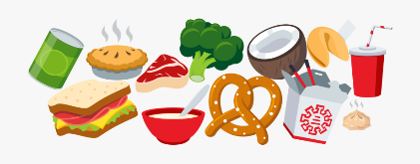
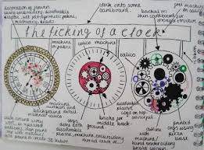
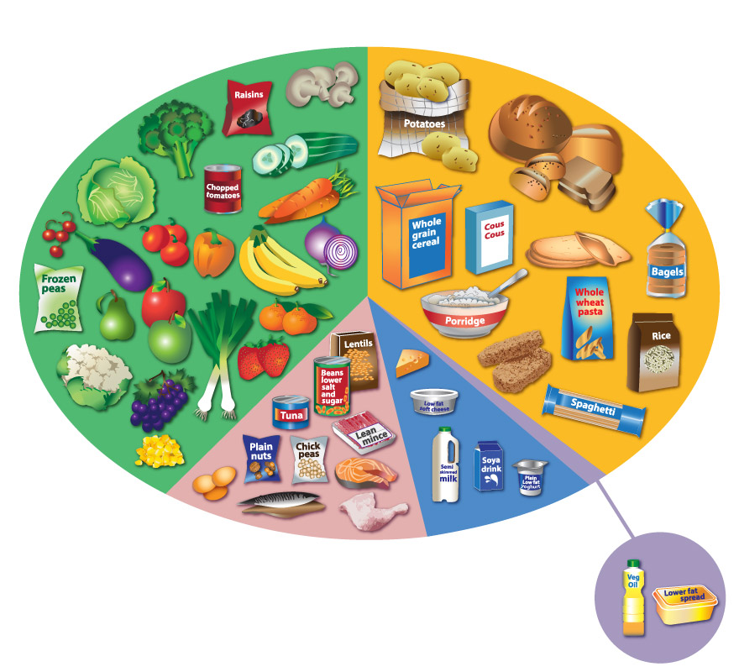
Knowledge Organiser: KS3 Food Technology
Food Groups and Hygiene
Key words
Specification Design Criteria Development Hygiene Food Groups Microbes Poisoning Carbohydrate Protein Water Fat Vitamin Mineral Fibre
Key skills
Product Specification: The ‘specification’ is probably the most important part of the design process because it makes sure your product is going to do what it needs to do. It is a list of points which outline the design criteria for the product, with each point referring to research work you have done. You can organize your points so you don’t miss anything using ACCESS FM and expand your writing using PEE chains.
Design idea development: First develop a range of initial ideas and compare them with your specification. You can then see any areas which are less good and look at how to improve them to produce a final idea. Annotation helps explain designs fully and using 3D sketching and ACCESS FM for your annotation will make your ideas clear. Improving and developing designs based on feedback is called iterative design.
Healthy diets: This is an eat well plate. The Eatwell Plate is a pictorial summary of the main food groups and their recommended proportions for a healthy diet. It is the method for illustrating dietary advice by the Department of Health. Use the eat well plate to help balance your diet.
Practical Pizza is a dough base that uses yeast similar to bread.
Curriculum Links
Literacy: specification writing, design communication, key words. Numeracy: Portion control, weighing, measuring, budgeting, Careers/Cultural Capital: Looking at local and cultural foods, hospitality and catering skills. BBC Bitesize links Hygiene in pizza! https://www.bbc.co.uk/bitesize/clips/zxfqxnb Pre cooked rice https://www.bbc.co.uk/bitesize/clips/zh8fb9q Low Fat Mayonnaise https://www.bbc.co.uk/bitesize/clips/zdy76sg
Key knowledge
Microbes are extremely tiny and are all around us. There are many different types, and some are Good and some are Bad for us.
Good Microbes | Live in yoghurts and probiotic foods | Live in our intestines. | Help us fight infections | Help us digest our food properly.
Bad Microbes | Causes food poisoning. | Grow on dirty surfaces. | Found on raw meat. | Make us ill -cause infections
Carbohydrates are starchy or sugary foods which give lots of energy. Examples of this food type are bread, potatoes and pasta. Try to eat more starchy foods than sugary ones!​
Proteins help the body to make and repair muscle. Too little of this food group can cause slow growth. Examples of this food type are meat and fish.​
Water is vital to keep our bodies hydrated. Recommended you drink 8 glasses a day! Its also in fruit juices.​
Fats give some energy but less than carbohydrates. They are used to keep the body warm. Examples of this food type are butter and oil.​
Vitamins and Minerals keep our bodies healthy and protect us from illness. Lots of these are found in fruit and vegetables or you can take them as a tablet too!​
Fibre helps to keep your gut healthy and make sure you absorb the nutrients in your food. You can get lots of Fibre from foods such as cereal and brown pasta.​

Slide 2
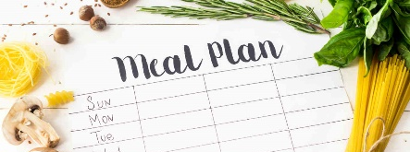
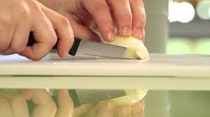
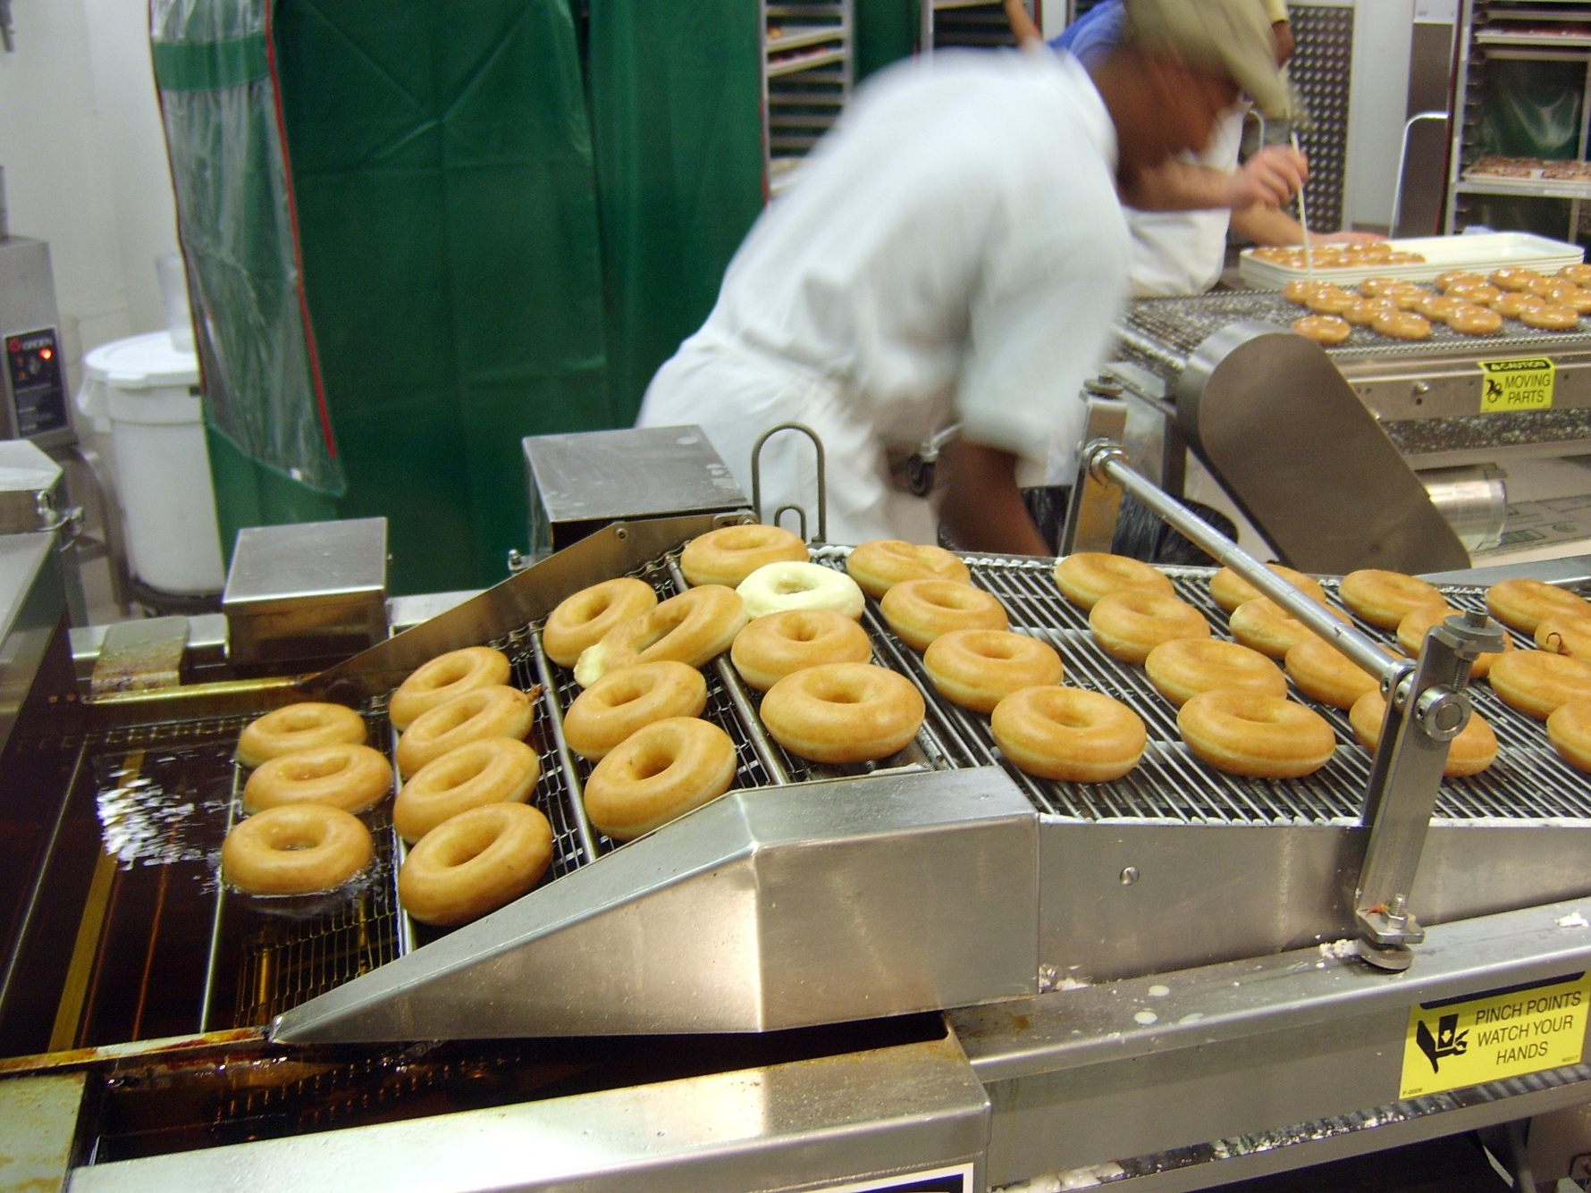
Knowledge Organiser: KS3 Food Technology
Planning and Mass Production
Key words
Manufacture Quality Production Pathogens The 4 C's Chilling Cooking Cleaning Cross Contamination Texture Jobs Function Flavour Vitamins Moisture
Key skills
Manufacturing: Using key manufacturing skills safely and practicing to develop your skill and accuracy so that the products you make are high quality. In Food Technology this includes knife skills, using a range of heating equipment such as cookers, hobs and microwaves as well as measuring equipment to manufacture different recipes.
Pathogens and food preparation: A pathogen in the oldest and broadest sense, is anything that can produce disease. A pathogen may also be referred to as an infectious agent, or simply a germ. The 4 C's can help to minimise pathogens.
Chilling: Leftover food needs to be handled and stored safely so that it does not pose a food safety risk, if there are leftovers after serving, place on a clean plate, cover and refrigerate within two hours.​ | Cooking: As all raw meats can carry harmful bacteria on the outside, it is important to cook all meat properly to kill the bacteria that can cause food poisoning.​
Cleaning: Regular cleaning of worktops, chopping boards and any surfaces that come into contact with food is important to prevent the spread of bacteria. Proper cleaning requires hot soapy water and a good scrub.​ | Cross contamination: When bacteria is spread by other foods or dirty hands from one surface to another.​
Production lines:A production line is a set of sequential operations in a factory where components are assembled to make a finished product that is suitable for onward consumption.
Practical: Chicken should be white in the middle when fully cooked.
Curriculum Links
Literacy: specification writing, design communication, key words. Numeracy: Portion control, weighing, measuring, budgeting, Careers/Cultural Capital: Looking at local and cultural foods, hospitality and catering skills. BBC bitesize links Automated production of bottles https://www.bbc.co.uk/bitesize/clips/z2v2tfr Chilling Broccoli https://www.bbc.co.uk/bitesize/clips/z4pd7ty
Key knowledge
Function of ingredients
Oats​ | Adds texture or crunchiness, bulks out the mixture, good source of carbohydrates and fibre, help to give a feeling of fullness, promote growth of good bacteria in gut.​
Butter​ | Provides flavour, Keep products moist and extend shelf-life​ Add colour to foods​ and binds mixture together​. Hold air when creamed with sugar​ and provide energy, Vitamins A and D.​
Self raising Flour​ | Provides fibre (especially if wholemeal), makes mixtures rise​. Thickens sauces, forms the bulk of bread, pastry and cake mixes​. If wholemeal, provides colour and texture, gluten in flour produces a stretchy dough, provides carbohydrate, vitamin B, calcium and iron.​
Brown sugar​ | Provides sweetness, provides colour and texture. Caramelises to produce a brown colour​. Retains moisture, Helps to trap air in cake mixtures, Provides carbohydrate.​
Chocolate /fruit​ | Provides sweetness, flavour, provides colour and texture.​ ​
Honey​ | A natural sweetener, honey extends a product’s shelf life by keeping it moister longer, honey inhibits mould growth in baked products. Honey helps to bind the ingredients.​

Slide 3
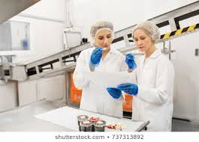
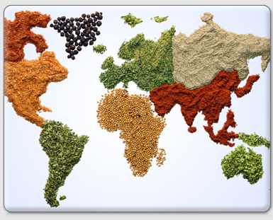
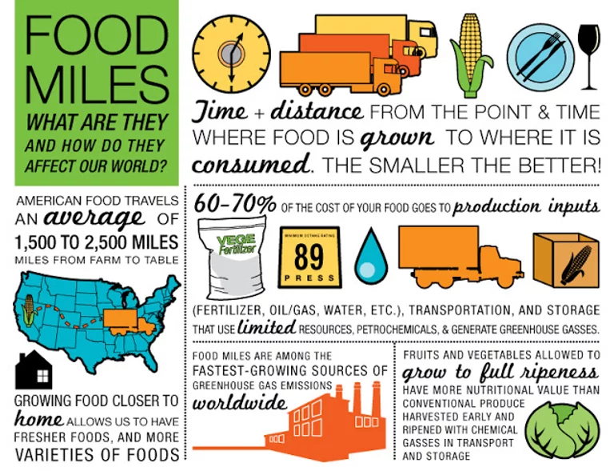
Knowledge Organiser: KS3 Food Technology
Designing and Evaluating
Key words
Cultures Testing Evaluating Feedback Taste Texture Cost Developing Reflecting Food miles Savoury Sweet
Key skills
Testing and Evaluating: By comparing your finished product with the specification and also by asking for 3rd party feedback, you can identify strengths and weaknesses with the design and manufacture of the item. You can use this information to suggest ways it could be improved or developed in the future.
Appreciating cultural foods. Some of the UKs favourite food comes from all over the world Italy – pizza , pasta and coffee. China – peking duck, prawn crackers and sweet and sour. France – macarons , cakes and baguttee. India - curry, nan bread and dal. America – burgers, fries and BBQs. Imagine how boring our food choices would be without the inflences we take from other culturs.
Cost analysis The weekly food allowance for a single person in their latest report is £46.31. I try and budget for around £40 per week, out of a total household allowance of £60. Portion control is important because it allows you to have a tight handle on how many calories you are consuming. This way, you eat what your body needs, instead of mindlessly overindulging. | PRICE FLUCTUATIONS. SEASONALITY. CONTAINER SIZE. STORAGE TEMPERATURE. TRANSPORT COSTS. FUEL COSTS. LOCATION OF FOOD.
Practical When cooking curry the spice content can be altered to taste as well as the thickness of sauce by adding cream.
Curriculum Links
Literacy: specification writing, design communication, key words. Numeracy: Portion control, weighing, measuring, budgeting, Careers/Cultural Capital: Looking at local and cultural foods, hospitality and catering skills. BBC bitesize links How noodles are made.https://www.bbc.co.uk/bitesize/clips/zjbxpv4 How prawn crackers are made. https://www.bbc.co.uk/bitesize/clips/zmchfg8
Key knowledge
Being able to describe the taste and texture of food is very important. Here are some examples. Bitter - Having a strong, often unpleasant taste e.g. coffee, dark chocolate. Sweet - Usually an enjoyable taste of sugar, Dry - Not wet. Moist - A little wet. Bland - Boring, not interesting. Spicy - Having strong flavours from spice. Savoury - Not sweet e.g. bread. Rich - Rich food has a lot of butter, cream, or eggs in it. Salty - Tastes of salt. Tasty - Good flavour and is nice to eat. Sugary - Tastes of sugar. Greasy - Containing or covered with fat or oil. Scrumptious - delicious. Sour - Having a sharp taste e.g yogurt, lemon. Piping hot -Very hot. Crunchy - Firm and making a loud noise when it is eaten.
Often many of our foods have come from lots of different countries. 9 Tips to Reduce Your Food Miles Shop Local Eat Seasonally Think About the Transport Method Use Farmer’s Markets and Local Small Stores Buying in bulk Cook From Scratch Eat Less Meat Don’t Drive to the Shops Grow Your Own food

Slide 4
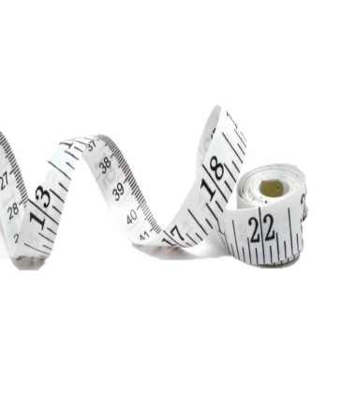
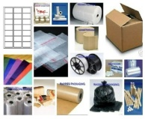
Structuring your answers in Design Technology
P.E.E Chains
In Technology we use PEE chains to expand our answers so we are communicating our thoughts and ideas clearly. This makes sure that we say what we think and then back up, or justify, our thoughts with explanations and evidence from research which support them.
POINT | Say WHAT you think. | I think the product should be…
EXPLAIN | Say WHY you think it. | This is because…
EVIDENCE | Say what RESEARCH you’ve done to back this up. | I know this from my research into…
ACCESS FM
ACCESS FM is an analysis and annotation tool which makes sure we consider all the important design criteria and the impact they have on products we are investigating, designing or evaluating,
A | Appearance | Where did the designer get their inspiration? Could the product look better? Do you think it looks attractive or ugly, Why? What does the product look like? THINK shape, form, materials, size, beauty, ugliness.
C | Cost | Is it affordable to your customer? Will it make a profit? Is it value for money? How much does it cost to make?
C | Customer | What impact would it have on a customers life? Why would a customer buy it? What makes it suitable for them? Who would buy it? Who would use it?
E | Environment | What is the products impact on the environment? THINK batteries, rethink, refuse, reduce, reuse, recycle, lifecycle. How would the product be disposed of? Is the product needed or wanted? How long will it last?
S | Safety | Is the product high quality? Does it meet safety standards? How has the designer considered safety? Could the product hurt anyone? Are there any sharp edges?
S | Size | Is it an appropriate size? Would it work better if it was bigger or smaller? Does it come in different sizes? How big is it?
F | Function | Does the product work? Could the product work better? How does the product work? Why is the product needed? What does the product do? Is it easy to use?
M | Materials/ Manufacture | What impact could the designer’s choice of material have on the environment? Would a different material make it better? What material has it been made from? What process would be used to make it?

Slide 5
Personalised Learning Checklist: KS3 Food Technology
Create a revision aid for each of the statements below, to prove you can do each one.
If you can definitely do the full task, tick green.
If you can do some of the task, tick amber.
If you can do less than half of the task, tick red.
If you have not ticked green, spend some extra time revising that area!
What’s a revision aid? This could be revision notes, a mind map, a list, flashcards. Whatever works for you! Look at the revision strategies page for more ideas.
KS3 FOOD TECHNOLOGY
Year 7 Module 1– Food Groups and Hygiene
Make a poster showing all the different food groups and some examples of each one.
Put 5 safety rules onto the back
Design a balanced menu for a teenager for a day.
Label each food group that they are eating.
Write a paragraph explaining why the menu is balanced.
Explain the risks if people do not follow hygiene rules in the kitchen.
Design a menu for a someone with a food allergy for a day.
Label each food group that they are eating and say what foods they can’t eat.
Write a paragraph explaining how you have made the menu balanced when their diet is restricted.
Explain the risks if people do not follow hygiene rules in the kitchen
Year 7 Module 2 - Planning and Mass production
Write a plan for making a cup of tea.
Write a paragraph explaining how you would need to change this plan if you were making 100 cups of tea.
Write a plan for making a sandwich.
Include quality checks and timescales for the sandwich.
Write a paragraph explaining how you would need to change this plan if you were making 100 sandwiches.
Write a plan for making a range of sandwiches.
Include quality checks and timescales for the different sandwiches.
Write a paragraph explaining how you would need to change this plan if you were making 100 of each sandwich.
Year 7 Module 3 – Designing and Evaluating
Look at a product you have designed and identify 4 criteria that your product must meet then say how your product meets the design criteria.
Use ACCESS FM to identify a full specification of criteria that your product must meet, then justify how your design meets each criteria using PEE chains.
Write a conclusion saying how good the design is.

