Slide 1
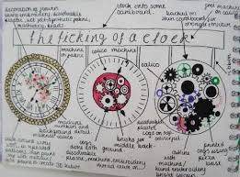
Knowledge Organiser: KS3 CAD & Engineering
Material Properties and Technical Drawings
Key words
Specification ACCESS FM (Appearance, cost, customer, environment, size, safety, function, materials and manufacturing method) Annotation Technical drawing BS 8888 Orthographic 2 dimensional 3 dimensional Quality Control Assurance
Key skills
Product Specification: The ‘specification’ is probably the most important part of the design process because it makes sure your product is going to do what it needs to do. It is a list of points which outline the design criteria for the product, with each point referring to research work you have done. You can organize your points so you don’t miss anything using ACCESS FM and expand your writing using PEE chains.
Design idea development: First develop a range of initial ideas and compare them with your specification. You can then see any areas which are less good and look at how to improve them to produce a final idea. Annotation helps explain designs fully and using 3D sketching and ACCESS FM for your annotation will make your ideas clear. Improving and developing designs based on feedback is called iterative design.
Technical Drawings: Technical drawings have to conform to BS 8888 which is a set of rules that the drawing must follow. Drawing Standards exist so that everyone using the drawing can understand them clearly and shows the information in the same way. Often the parts being shown on the drawings are too big to draw full size, so they are drawn to scale. This means drawing them in model but as a smaller size than they really are. The scale being used is shown on the drawing in the title block. | Orthographic drawing layout: |  | 2D drawing technique which shows the top (plan), front and side (end) view of a product. Used to show technical information such as dimensions clearly.
Curriculum Links
Literacy: Specification writing, PEE chains, justification and analysis skills, use of acronyms. Numeracy: Costing, dimensions, scale, proportion, graphical representation. Careers: Problem solving, software skills, communication skills. Cultural Capital: Specification writing, design skills, communication.
Key knowledge
2D Command Tools: | Quality control and Quality Assurance: Quality control is a system of maintaining standards in manufactured products by testing a sample of the output against the specification. Quality Assurance is a way of preventing mistakes and defects in manufactured products and avoiding problems when delivering products or services to customers. Quality assurance makes sure quality is created during the designing phase. Whereas in quality control, quality is created at the production stages. Quality Assurance is a preventive action, but Quality Control is a corrective measure.

Slide 2
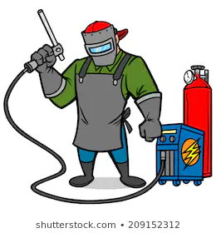
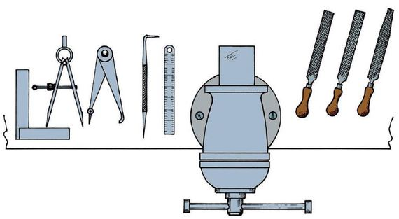
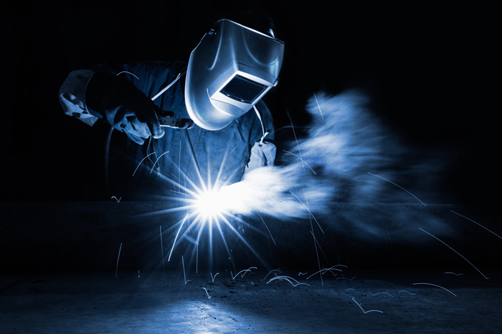
Knowledge Organiser: KS3 CAD & Engineering
Manufacturing Safely
Key words
Manufacture Risk Assessment Welding Quality Laser cutting Drilling Vectorise Import Hazard Control DXF file Safety Strength Ductility Elasticity Ductility Plasticity Tensile
Key skills
Manufacturing: Using key manufacturing skills safely and practicing to develop your skill and accuracy so that the products you make are high quality. In Engineering this includes hand tools, heat treatment, laser cutting, drilling and welding.
Laser cutting process: Draw your image on 2D design, or vectorise an existing image. Then change cut lines to red and engrave lines to black. |  | Risk Assessment: This term is used to describe the overall process or method where you: Identify hazards and risk factors that have the potential to cause har. After hazard identification, you then consider appropriate ways to eliminate the hazard, or control the risk when the hazard cannot be eliminated, this is called risk control.
 | Export the image as a DXF file to the laser cutter. Place the material into the laser and follow the settings and safety rules in the handbook to cut it out correctly.
Key knowledge
Material properties: Strength – The ability of a material to stand up to forces being applied without it bending, breaking, shattering or deforming in any way. Elasticity – The ability of a material to absorb force and flex in different directions, returning to its original position. Ductility - The ability of a material to change shape (deform) usually by stretching along its length. Plasticity - The ability of a material to be change in shape permanently. Tensile Strength - The ability of a material to stretch without breaking or snapping. | Advantages and Disadvantages of welding:
 | Advantages: Strong Lightweight joint More effective than riveting Look neat and tidy Quick to produce Rigid No noise | Disadvantages: Brittle Don’t cope well with fatigue Skilled labor needed to weld Electricity is required for welding. Inspection of welding work is more difficult and costly than riveting. Easy to get defects in the joint which are difficult to detect. Risks are higher from welding flash
Properties of steel: Steel is an alloy of iron and carbon and, sometimes, other elements such as chromium. Because of its high tensile strength and low cost, this material is best used in buildings, infrastructure, tools, ships, trains, cars, machines, electrical appliances, and weapons.
Curriculum Links
Literacy: Risk assessment, processing instructions, use of technical documentation. Numeracy: Planning, dimensions, marking out. Careers: Problem solving, hand skills, communication skills. Cultural Capital: H&S/Risk awareness, manufacturing skills, communication.

Slide 3
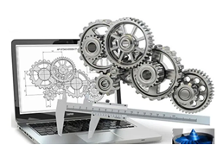
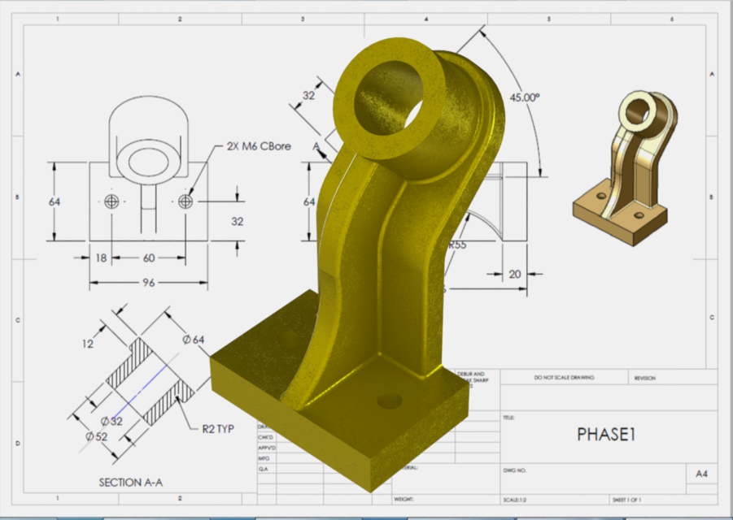
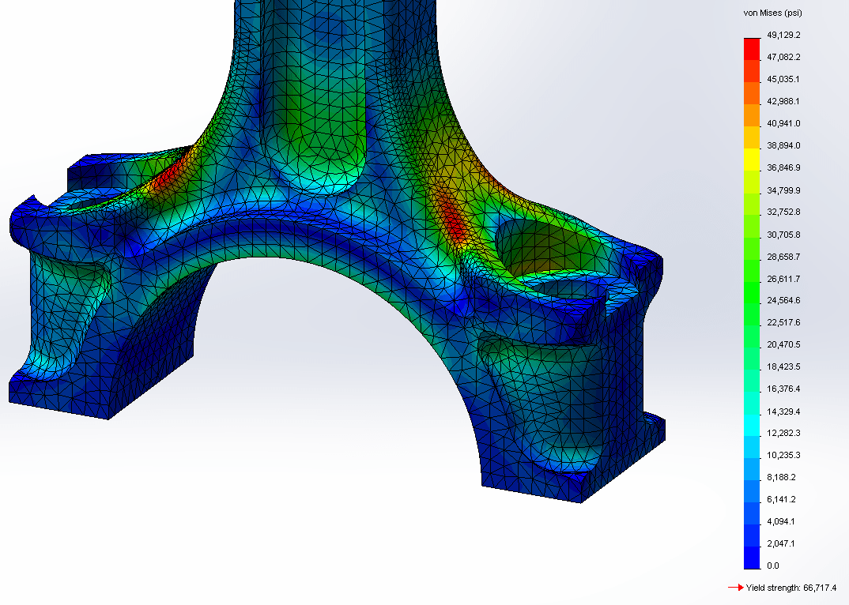
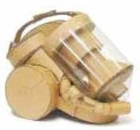
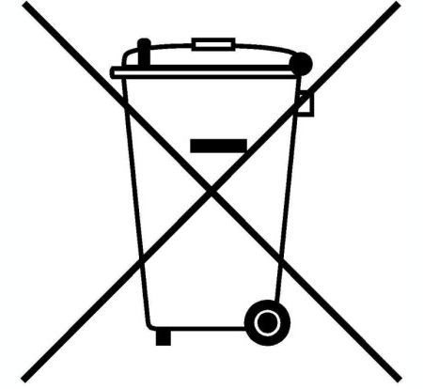
Knowledge Organiser: KS3 CAD & Engineering
Computer Aided Design
Key words
Testing Evaluating Computer Aided Design Modelling Rendering Virtual Technical 3rd party feedback Heat treatment Crystalline Characteristic Forge Shade Tone
Key skills
Testing and Evaluating: By comparing your finished product with the specification and also by asking for 3rd party feedback, you can identify strengths and weaknesses with the design and manufacture of the item. You can use this information to suggest ways it could be improved or developed in the future.
CAD: 3D computer modelling means using a computer programme to create a virtual representation of a real object. This drawing can then be used to programme a piece of machinery to cut out a real physical product. The model can also be rendered to make it look real by choosing a colour and a material. A number of 3D model parts can be put together to make an assembly. Once the complete 3D model is created, it can be used to create a technical drawing. These drawings are used when the product is made to make sure it is the right shape and size.
Card modelling: Card modelling is another way to test a design before proper production begins. One major advantage of using card is if you make a mistake, each part can be remodeled at very little cost. When assembled correctly they can be really strong and last for many years. |  | Heat treatment: Heat Treatment in Design and Technology involves the use of heat to raise the temperature of a material (usually metal) to a point where changes in its crystalline structure occur and alter its working characteristics. Often this means it is easier to work with and shape. The source of heat could be a Blow Torch but in industry, more consistency and accuracy is achieved by the use of temperature controlled ovens and kilns.
Creating a card model is easy and can quickly show what a product will look like so it can be evaluated.
Curriculum Links
Literacy: Risk assessment, processing instructions, use of technical documentation. Evaluation. Numeracy: Checking, estimating, dimensions, marking out. Careers: Problem solving, hand skills, communication skills. Cultural Capital: Manufacturing skills, communication, production.
Key knowledge
Target audiences: When designing you need to think about the customer, client and end user. Sometimes they will be the same, but often they are different people who will have different needs and wants from the product. For example a dog bowl. The client might be a pet shop, the customer would be the pet owner and the end user would be the dog. Whose needs are most important will depend on the product being made. | Environmental impacts of products: When designing a product it is important to think about the environmental impacts all the way through the product’s life. This might be the energy used in the extraction of raw materials or during manufacturing. It could be the transport of materials or finished products for sale. It will also include any consumable items when the product is being used, like batteries, as well as how the product will be disposed of at the end of its life.

Slide 4
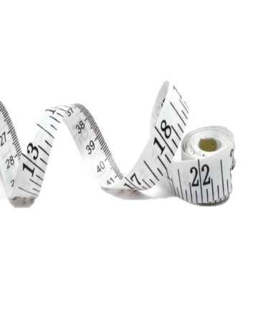
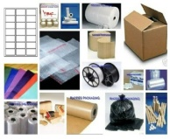
Structuring your answers in Design Technology
P.E.E Chains
In Technology we use PEE chains to expand our answers so we are communicating our thoughts and ideas clearly. This makes sure that we say what we think and then back up, or justify, our thoughts with explanations and evidence from research which support them.
POINT | Say WHAT you think. | I think the product should be…
EXPLAIN | Say WHY you think it. | This is because…
EVIDENCE | Say what RESEARCH you’ve done to back this up. | I know this from my research into…
ACCESS FM
ACCESS FM is an analysis and annotation tool which makes sure we consider all the important design criteria and the impact they have on products we are investigating, designing or evaluating,
A | Appearance | Where did the designer get their inspiration? Could the product look better? Do you think it looks attractive or ugly, Why? What does the product look like? THINK shape, form, materials, size, beauty, ugliness.
C | Cost | Is it affordable to your customer? Will it make a profit? Is it value for money? How much does it cost to make?
C | Customer | What impact would it have on a customers life? Why would a customer buy it? What makes it suitable for them? Who would buy it? Who would use it?
E | Environment | What is the products impact on the environment? THINK batteries, rethink, refuse, reduce, reuse, recycle, lifecycle. How would the product be disposed of? Is the product needed or wanted? How long will it last?
S | Safety | Is the product high quality? Does it meet safety standards? How has the designer considered safety? Could the product hurt anyone? Are there any sharp edges?
S | Size | Is it an appropriate size? Would it work better if it was bigger or smaller? Does it come in different sizes? How big is it?
F | Function | Does the product work? Could the product work better? How does the product work? Why is the product needed? What does the product do? Is it easy to use?
M | Materials/ Manufacture | What impact could the designer’s choice of material have on the environment? Would a different material make it better? What material has it been made from? What process would be used to make it?

Slide 5
Personalised Learning Checklist: KS3 CAD & Engineering
Create a revision aid for each of the statements below, to prove you can do each one.
If you can definitely do the full task, tick green.
If you can do some of the task, tick amber.
If you can do less than half of the task, tick red.
If you have not ticked green, spend some extra time revising that area!
What’s a revision aid? This could be revision notes, a mind map, a list, flashcards. Whatever works for you! Look at the revision strategies page for more ideas.
KS3 CAD & ENGINEERING
Year 9 Module 1 – Material Properties and Technical Drawings
Make a poster showing all the different material properties.
Draw the top front and side view of your mobile phone on the back.
Create a table showing the different materials properties.
Give an example of each type of material and why it is used.
Explain the views shown in an orthographic drawing and why they are used.
Create a table showing the different materials properties.
Give an example of each type of material and why it is used.
Year 9 Module 2 – Manufacturing Safely
Write a plan for making a coat hook.
Write a paragraph explaining each of the stages and what safety measures you needed to take when working.
In a table, identify each stage in making your coat hook and say what tools were needed.
Write a risk assessment showing who might be harmed and how at each stage.
Include the control measures used to prevent you from being harmed.
Year 9 Module 3 – Computer Aided Design
Explain what is meant by CAD.
Write a paragraph explaining the benefits of using CAD and CAM in engineering.
In a table compare and contrast the advantages and disadvantages of using CAD and CAM.
Write a conclusion of what you have found.
Write an essay discussing the following statement: Using CAD and CAM is bad for people because it costs jobs.

