Slide 1
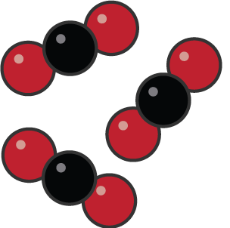
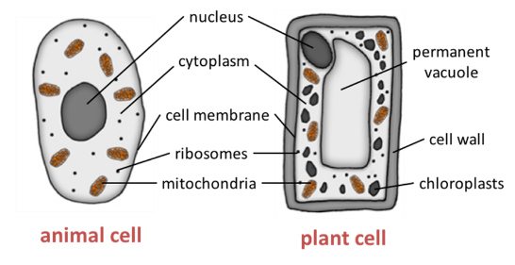
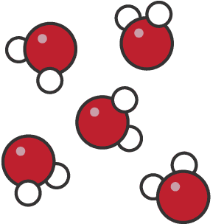
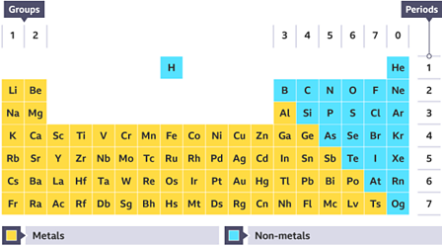
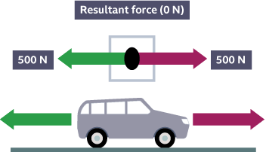
Year 7
Science
Revision Knowledge Organisers

Slide 2
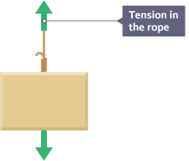
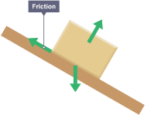

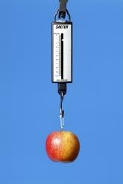
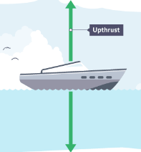

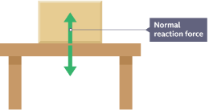
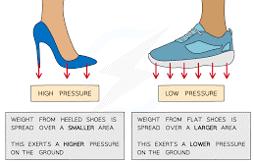
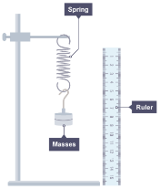
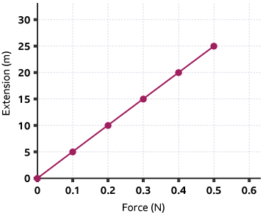
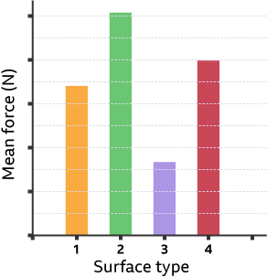
Forces : Year 7 : Cycle 1
Lesson 1: Forces and Their Effects
Lesson 2: Contact Forces
Lesson 3: Friction
A force is a push or a pull that acts on an object due to the interaction with another object.
Force is measured in Newtons (N).
Forces are divided into contact forces and non-contact forces.
Contact forces act between two objects that are physically touching.
Here are some examples of contact forces
Frictional forces occur in many different situations.
Frictional forces stop us from slipping when we walk and slow down a cyclist when they stop pedalling.
Friction is a contact force and acts against the movement of an object.
A force meter, also known as a newton meter, can be used to measure the size of a force
Thrust
We can limit the amount of friction using lubrication. Substances like motor oil can be used to stop metal parts from rubbing and wearing away.
Lesson 6: Pressure (Solids)
Lesson 5 Hooke's Law
Lesson 4: Friction Skills
Pressure is a measure of how much force is acting on an area.
Pressure depends on both the force and the area, and is found using the relationship:
Pressure = Force ÷ Area
This means that a smaller area will create a greater pressure with the same force acting on it.
When you apply a force to a material it can extend. The extension is the amount the length has increased by.
Investigate friction by comparing the amount of force needed to move an object on different types of surfaces.
To investigate Hooke’s law, you can add masses to a spring and measure the length of the spring when the weight of the masses is increased.
Independent variable - the type of surface
Dependent variable - the amount of force needed to move at a constant velocity
Control variables - the speed of the object and the mass of the object

Slide 3

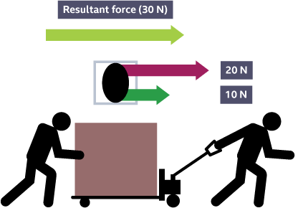
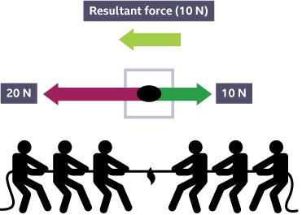

Forces : Year 7 : Cycle 1
Lesson 7: Non-Contact Forces
Lesson 8: Balanced and Unbalanced
Non-contact forces act between two objects that are not physically touching.
Forces acting on an object are shown using arrows. The arrows represent the size and direction of the forces acting.
A resultant force is the overall force that acts on the object.
If the resultant is zero (balanced )the object travels at constant speed.
If the resultant is not zero (unbalanced) the objects accelerates in the direction of the larger force.
Magnetic force
Electrostatic force
Gravitational force
Forces acting in the same direction
Add the forces = 20 + 10 = 30N (Right)
Forces acting in the opposite direction.
Subtract the forces = 20 -10 = 10N (Left)
Keywords
Newton | Contact Force | Non-contact Force | Magnitude | Tension | Thrust
Friction | Air Resistance | Upthrust | Normal Reaction | Magnetic | Electrostatic
Gravitational | Resultant | Balanced | Unbalanced | Weight | Lubrication
Anomalous | Streamlining

Slide 4

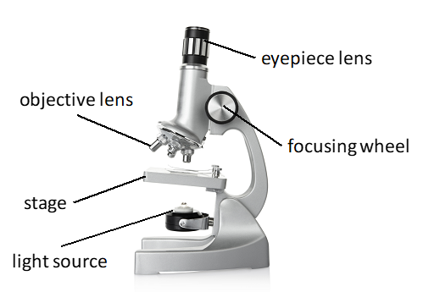
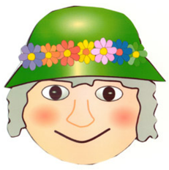
Year 7 Biology Cycle 1 Cells
Cells – the building blocks of life
The Light Microscope
The Characteristics of Life
There are 7 life processes that all living things carry out.
We can remember them using “MRS GREN”
Movement
Reproduction
Sensitivity
Growth
Respiration
Excretion
Nutrition
Part | function
Nucleus | Controls cell, contains DNA
Cytoplasm | Where cell reactions occur
Cell membrane | Controls what can enter/leave the cell
mitochondria | Where respiration (release of energy) happens)
ribosomes | Protein synthesis
Cell wall | Supports and protects cell
vacuole | Full of liquid, supports cell
chloroplast | Where photosynthesis happens
A microscope magnifies objects so that they seem bigger (it does not zoom in!)
The object you are looking at is placed on a glass slide on the stage.
The lenses magnify the object.
Eyepiece x10
Objective lenses x4, x10, x20
The focusing wheel is moved to make the image look clear. (in focus)
Total magnification = eyepiece lens x objective lens
Eg 10 x 4 = x40
The specimen must be thin to allow light to pass through it. A stain is used to allow it to be seen clearly
Process | description
Movement | Moving from place to place (animals) or moving part of the body eg plants move leaves to the light
Reproduction | Making more of the species
Sensitivity | Responding to the environment
Growth | Increasing in size
Respiration | Releasing energy from food
Excretion | Getting rid of waste materials made by cells
Nutrition | Needing nutrients (food)
All living things are made up of cells. They are too small to see with the naked eye so we use a microscope.
Multicellular organisms are made up of many cells.
Unicellular organisms are made up of only one cell.
Some cells are specialised to carry out a particular function or job.

Slide 5
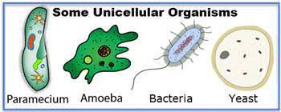
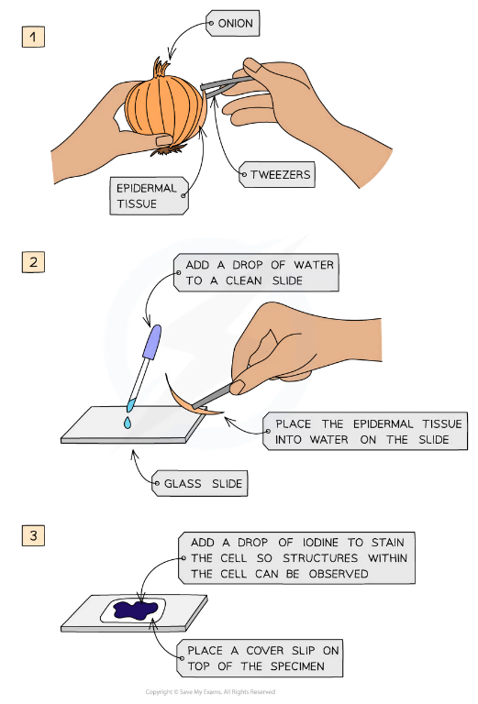
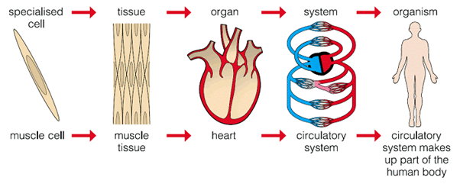
Unicellular or Multicellular?
Year 7 Biology Cycle 1 Cells
Cells, Tissues, Organs and Systems
In a multicellular organism, cells work together as tissues eg muscle cells make up muscle tissue, xylem cells make up xylem tissue
Tissues work together as organs eg heart contains muscular tissue, a leaf contains different tissues (palisade, xylem, phloem)
Organs work together as organ systems to carry out the 7 life processes
Organ systems make up organisms…
Unicellular organisms are made of only 1 cell
(“Uni” means 1 – a unicycle has 1 wheel).
We can use a microscope to observe unicellular organisms and cells from multi cellular organisms.
Making a slide of onion skin cells
Unicellular organisms obtain all the materials that they need to survive across the cell membrane by a process called diffusion.
Diffusion is when a substance moves from where there is more of it to where there is less (a high concentration to a low concentration)
Eg. Oxygen will diffuse from the water (where there is a lot) into the amoeba (where there is less).
This only works because the organisms are so small.
Multicellular organisms are made of many cells (sometimes billions). They cannot obtain the materials they need by diffusion because they are too big.
Instead they have transport systems and other organ systems..
Circulatory system (transport)
Digestive system
Skeletal system
Nervous system
Reproductive system
Respiratory system

Slide 6
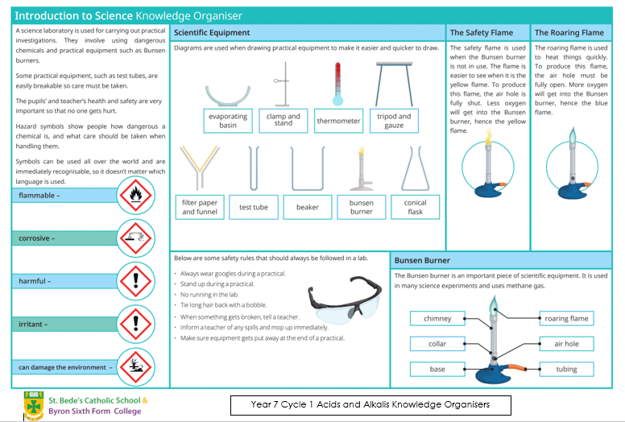

Slide 7
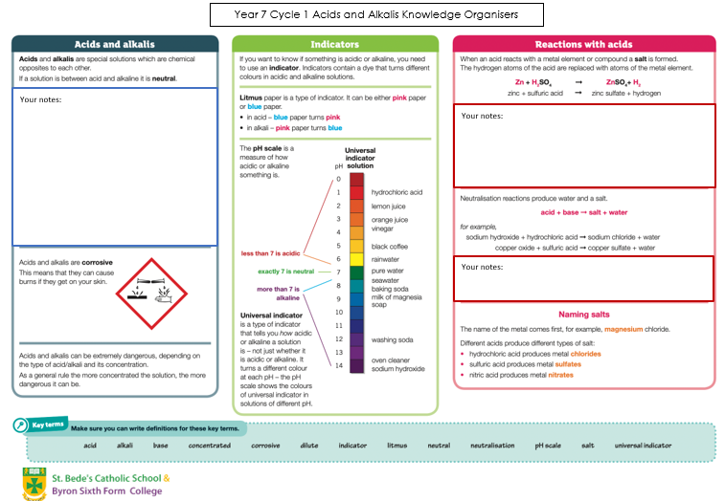

Slide 8

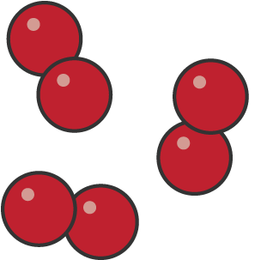
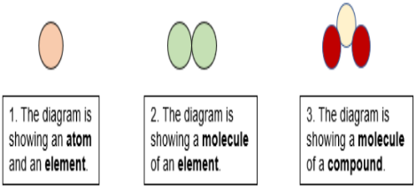
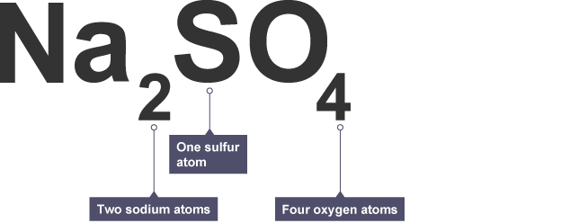
Year 7 – Cycle 2 – Chemistry - Atoms, Elements & Compounds
Keywords & definitions
Lesson 1 Atoms
Lesson 2 & 3 Elements & The Periodic Table
Key Words | Definitions
Atom | The smallest part of an element that can take part in chemical reactions. No overall electrical charge. Very small, radius of 0.1nm.
Element | An element contains only one type of atom. Found on the Periodic Table. There are about 100 elements.
Compound | Two or more different elements chemically bonded with each other.
Molecule | Two or more atoms joined together
Periodic table | A table that contains all of the known chemical elements.
Chemical formulae | Shows the particles present in a compound and the relative proportions of elements.
Atoms are very small particles that cant be seen directly
All matter is made of atoms
A piece of pure copper contains only copper atoms.
A piece of pure lead contains only lead atoms.
The Dalton Model of an atom
Dalton ( a scientist) concluded these three things about atoms
All matter is made up of atoms
There are different types of atom
Each element contains a different type of atom
An element is a substance that cannot be broken down into any other substance. Every element is made up of its own type of atom.
Elements have different properties eg. Copper is a soft bendy metal and oxygen is a colorless gas.
A molecule is two or more atoms bonded together.
Everything in the universe contains the atoms of at least one or more elements.
The periodic table lists all the known elements and groups together those with similar properties.
Copper atoms
Oxygen molecules
Lesson 5 Making Compounds
Lesson 4 Compounds
Compounds often have different properties to the elements they are made from
When two different elements combine, the name of the compound usually ends –ide
Eg sodium + chlorine → sodium chloride
Magnesium + oxygen → magnesium oxide
When three or different elements combine, and one of them is oxygen, the name of the compound usually ends –ate
Eg Sodium + carbon + oxygen → sodium Carbonate
Copper + sulfur + oxygen → copper sulfate
A compound is a substance that contains atoms of two or more different elements, and these atoms are chemically joined together.
For example, water is a compound of hydrogen and oxygen. Each of its molecules contains two hydrogen atoms and one oxygen atom.
Carbon dioxide molecules
Water molecules
Lesson 6 Chemical formulae
We use chemical symbols to stand for the elements. For example, C stands for carbon, O stands for oxygen, S stands for sulfur and Na stands for sodium.
For a molecule, we use the chemical symbols of the atoms it contains to write down its formula.

Slide 9
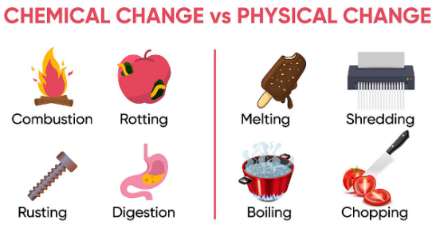
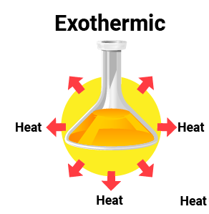
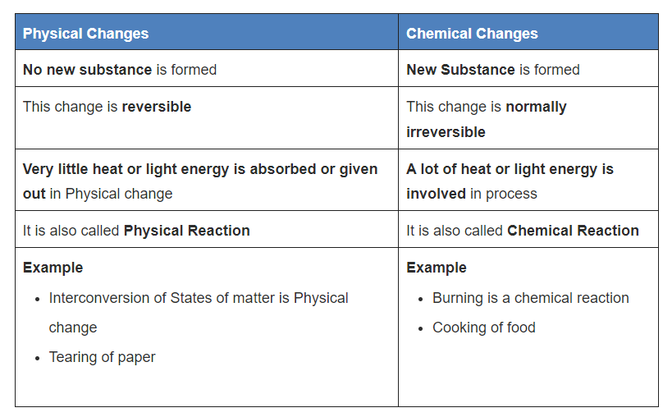
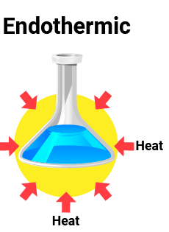
Year 7 – Cycle 2 – Chemistry - Atoms, Elements & Compounds
Lesson 7 – Chemical & Physical change
Lesson 8 – endothermic & exothermic
Physical Changes
There are 3 states of matter
  Solids, liquids & gases
Examples of Physical changes are
  changes of state and dissolving
Physical processes are reversible ( they can be undone)
Physical process do not make new substances
Chemical change
Examples of chemical change
  Any chemical reaction ( neutralisation, combustion etc)
Chemical Changes are irreversible ( they cannot be undone)
Chemical changes do make new substances
All reactions have a change in energy. The energy is usually transferred by heating .
Exothermic Reaction:
Transfers energy to the surroundings – shown by an increase in temperature ( things feel hotter)
Reactions include: Combustion ( burning)
Uses include: Hand warmers
Endothermic Reaction:
Takes in energy from the surroundings – shown by a decrease in temperature ( things feel colder)
Reactions include: Thermal decomposition (breaking down using heat)
Uses include: Sports injury packs

Slide 10
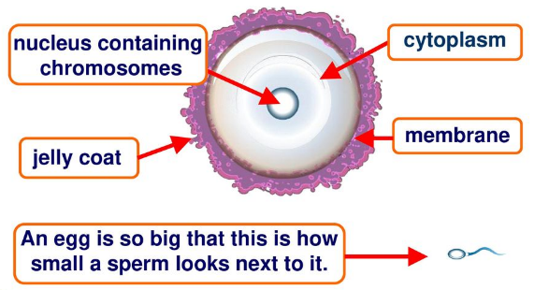
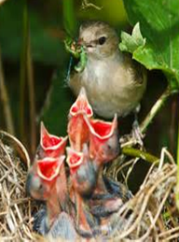
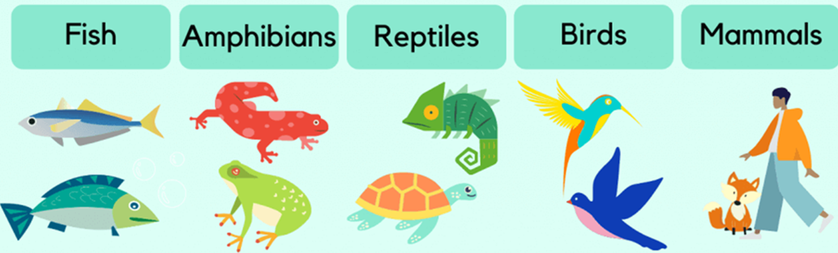
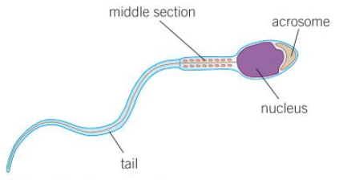
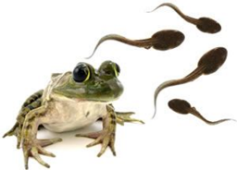
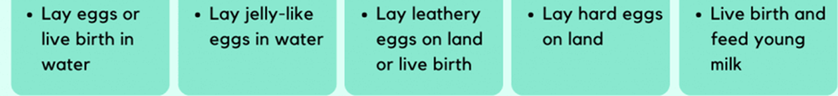
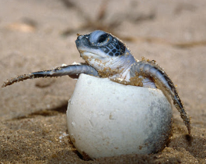
Cycle 2 Reproduction Knowledge Organiser
7 Characteristics of Life:
Movement
Reproduction = making more individuals
Sensitive
Growth
Respiration
Excretion
Nutrition
The egg:
There are 2 types of reproduction – sexual and asexual.
Sexual reproduction involves 2 parents and specialised sex cells called gametes.
The male gamete is the sperm.
The female gamete is the egg.
Different animals reproduce in different ways…
The sperm:
Chemical to dissolve egg cell membrane
Contains lots of mitochondria to releases energy to swim
To swim to the egg
More eggs
Less parental care
More eggs
Less parental care

Slide 11
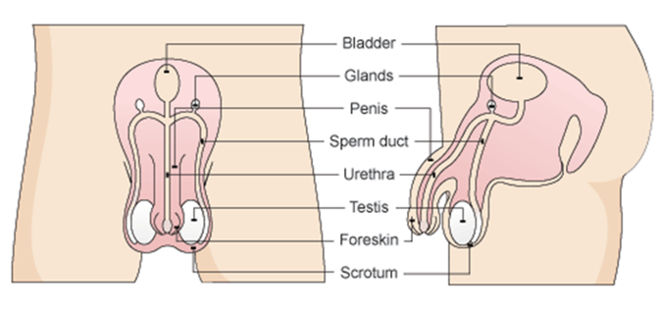
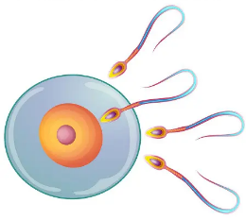
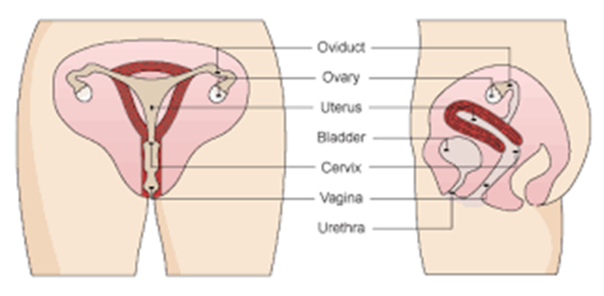
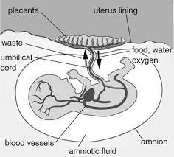
Reproductive systems:
Gestation (pregnancy)
Fertilisation is when the nucleus in the sperm and the nucleus in the egg fuse (join).
Fertilisation normally happens in the oviduct.
The zygote divides into a ball of cells called an embryo.
The embryo implants into the uterus wall and grows a placenta and umbilical cord.
BIRTH
When the baby is ready to be born, it turns so that the head is facing downwards.
The “waters” break (the amniotic sac breaks and the fuid leaks out) and contractions start. These are the muscles in the uterus wall contracting to push the baby out.
The gestation period (pregnancy) of a human is 9 months or 40 weeks.
Male Reproductive System
Only 1 sperm fertilises the egg.
The fertilised egg is called a zygote.
Puberty
This is the time when the body changes and a child becomes an adult. This is caused by hormones.
The male hormone is called testosterone
The female is called oestrogen.
Sperm are made in the testes.
They travel along the sperm duct.
Liquid is added by the glands.
Semen leaves through the penis.
Changes in girls | Changes in boys | Changes in both
Periods start | Testes make sperm | Pubic hair
Breasts develop | Penis gets bigger | Body hair
Hips get wider | Shoulders get wider | sweat
 | Facial hair | Spots
 |  | Mood swings
Female Reproductive System
Oxygen and nutrients pass from the mums blood to the fetus’s blood across the placenta and down the umbilical cord.
Waste materials such as carbon dioxide and urea move in the opposite direction.
The eggs (ovum) are released by the ovaries.
The egg is fertilised in the oviduct.
The fetus develops in the uterus.

Slide 12
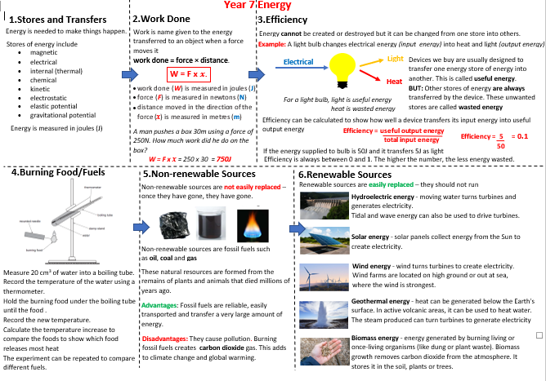

Slide 13
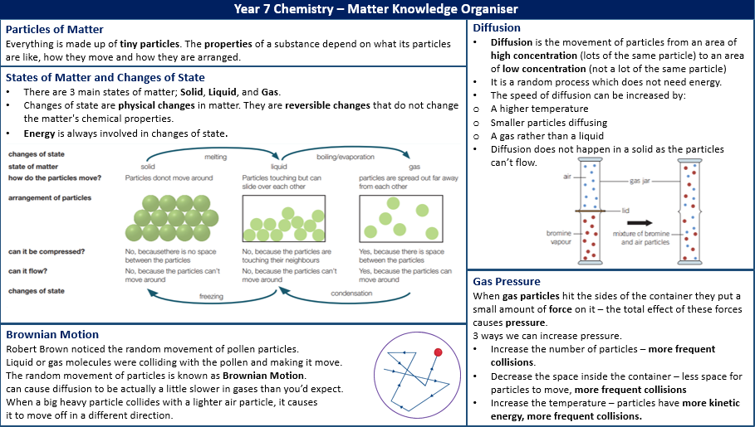

Slide 14
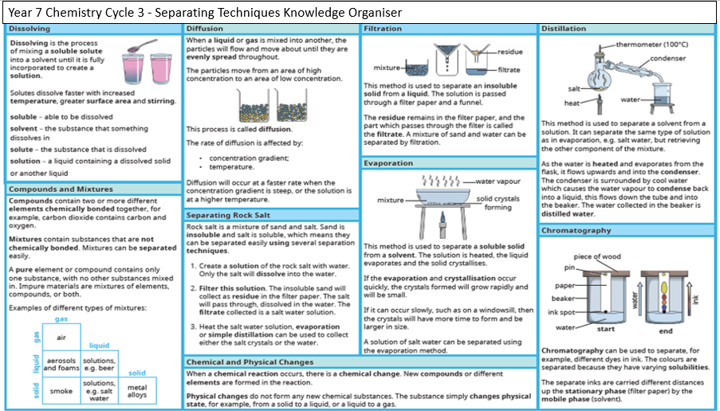

Slide 15
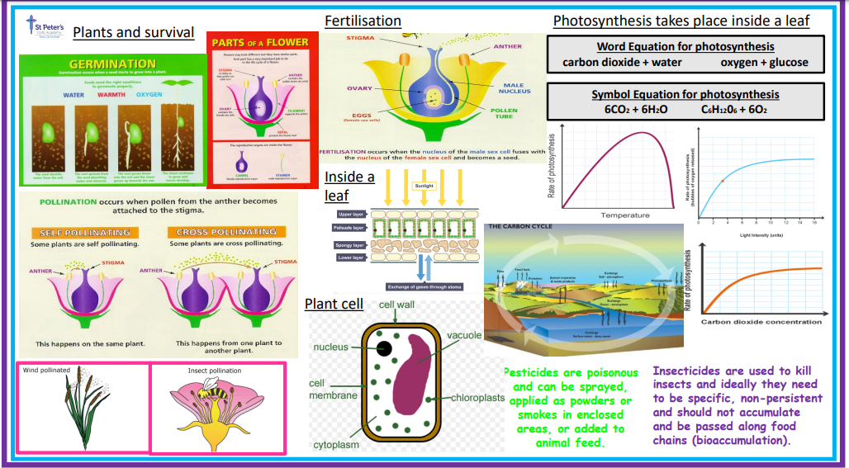

Slide 16
