Slide 1
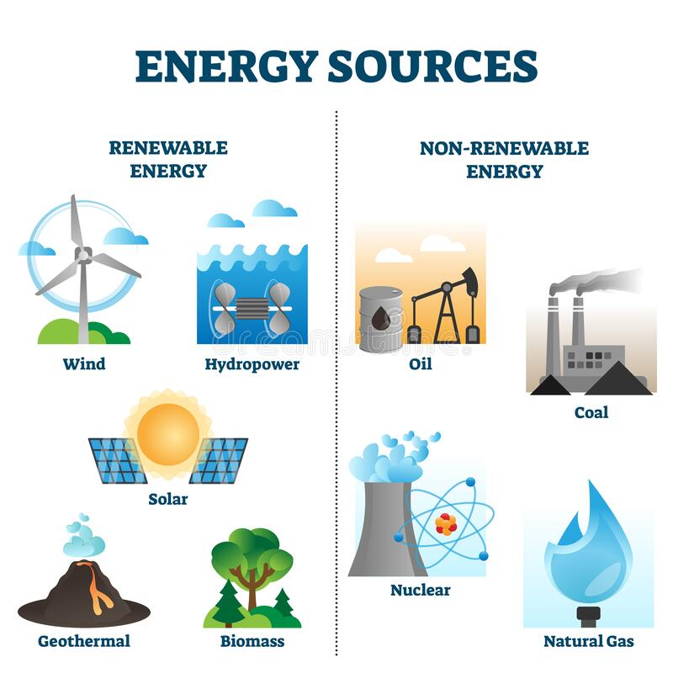
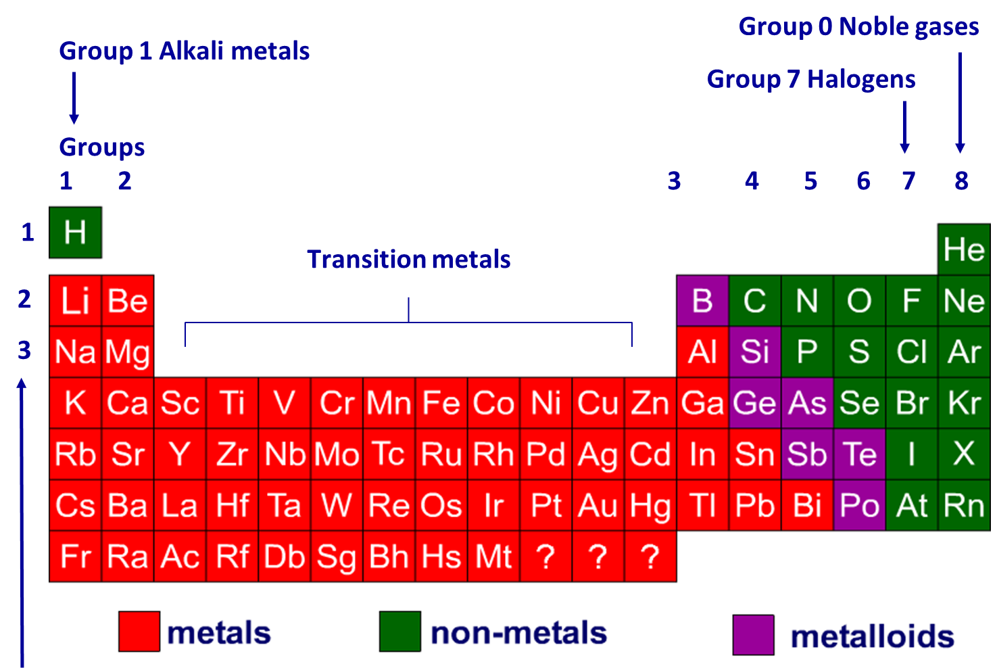
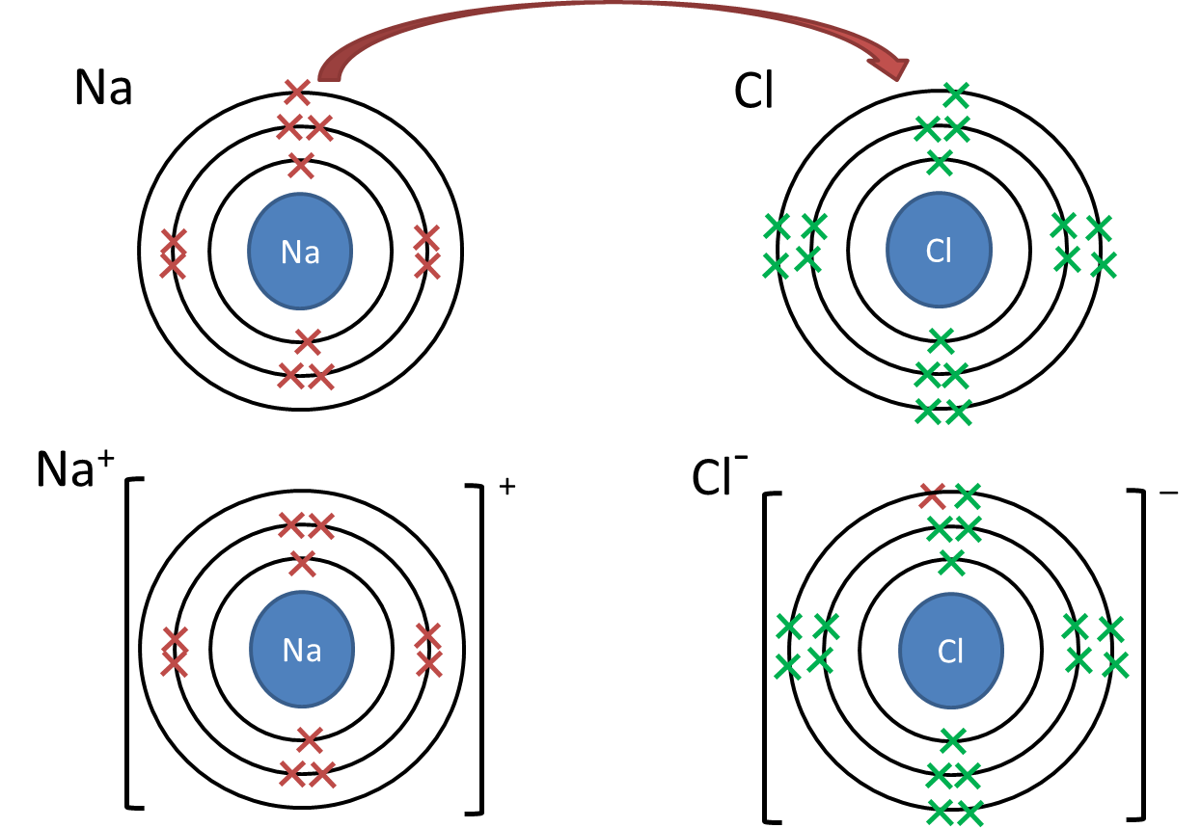
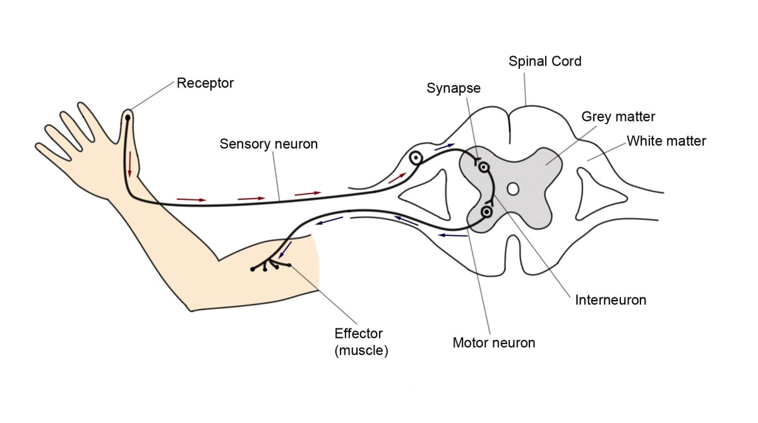
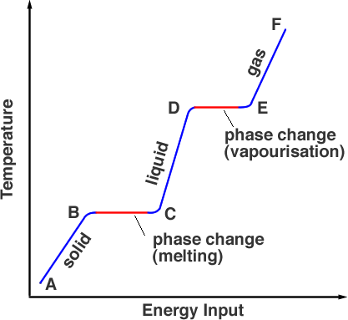
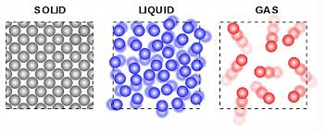
Year 9 Science
Revision Knowledge Organisers

Slide 2
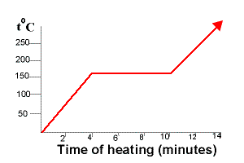
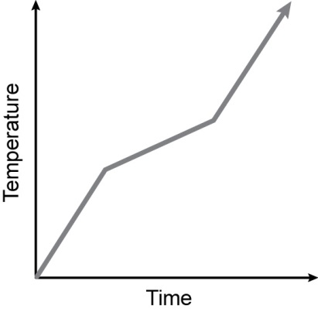
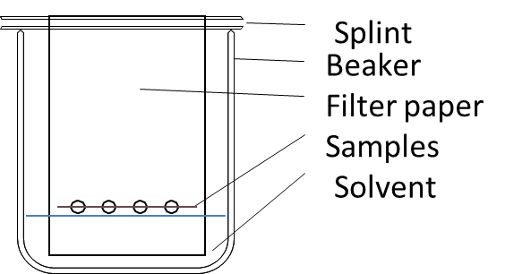
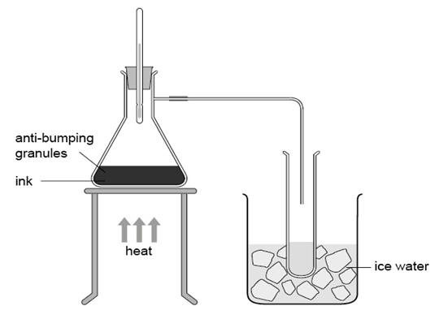
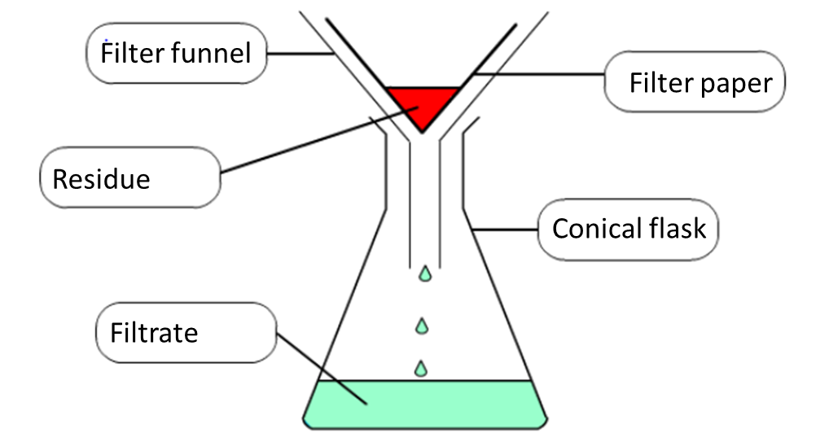
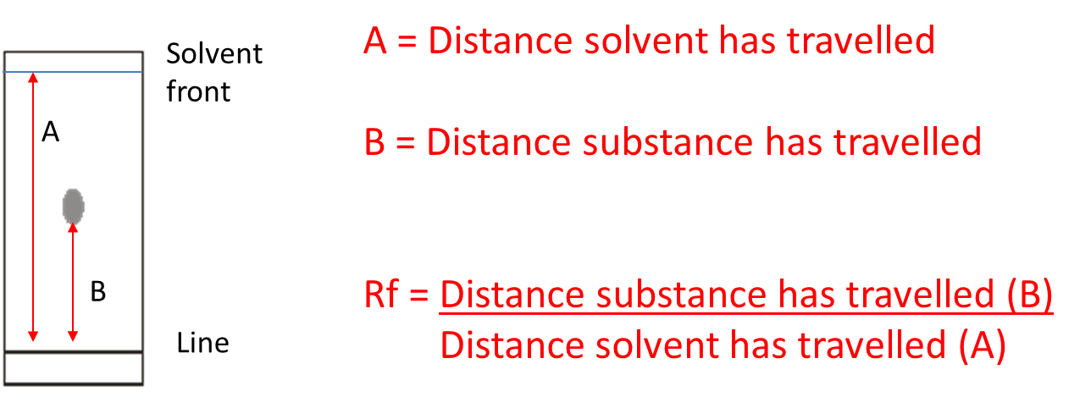
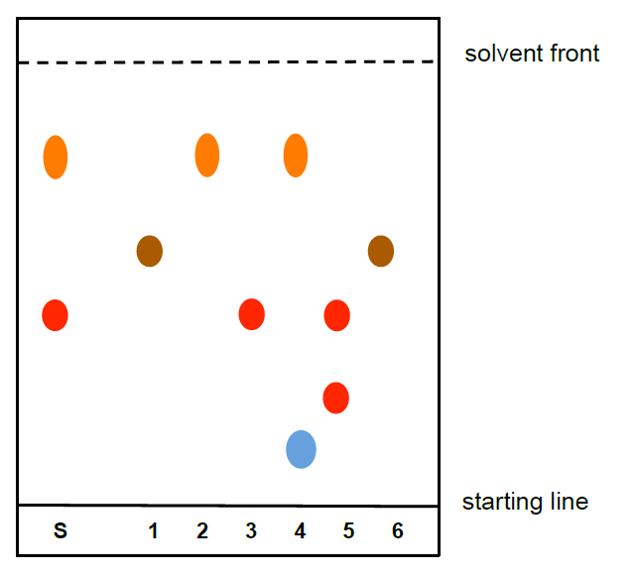
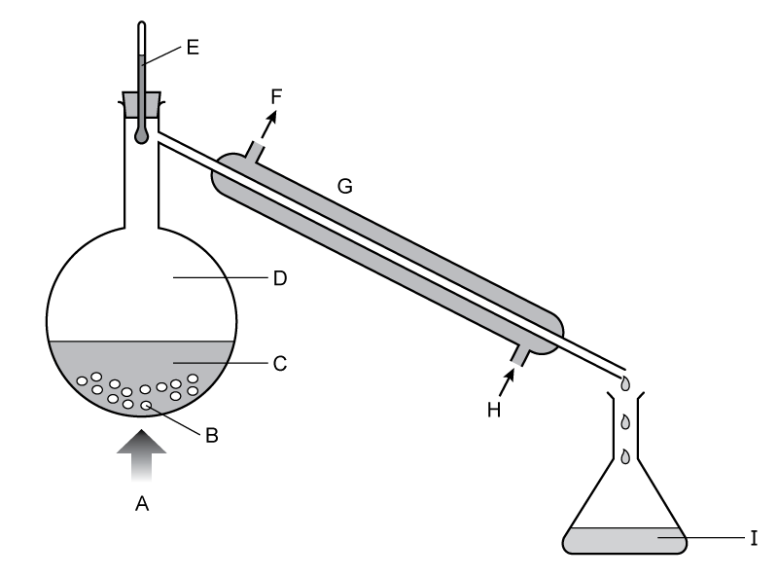
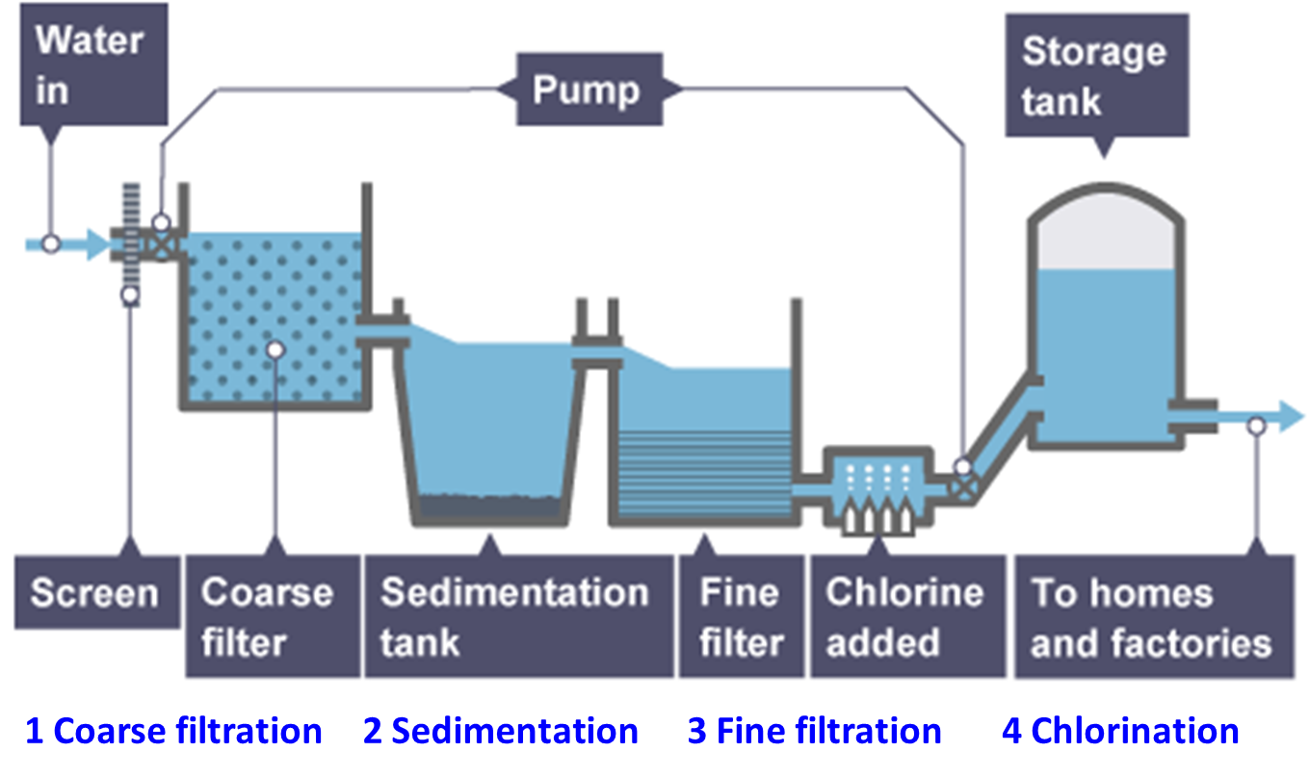
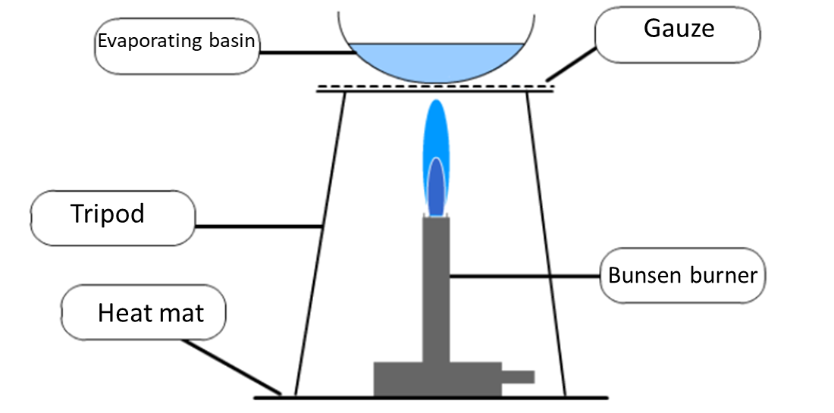
Y9 Cycle 1 - States of matter, separating and purifying knowledge organiser
Lesson 1 States of matter
State Changes
Lesson 2 Heating / Cooling curves
Lesson 3 Mixtures
Mixtures contain substances which are not chemically combined and they can be separated
Pure materials contain only one substance
Impure materials contain a mixture of substances
Pure substances have a sharp melting point
Impure substances have a range of melting points Pure Impure
Condensation
Evaporation
/ boiling
Evaporation
Arrangement of particles
Ordered Random Random
Neat rows Some touch Apart
Movement of particles
Vibrating Rolling over Flying around
about fixed position each other with high energy
Increasing Energy
Freezing
Melting
Time
A heating or cooling curve shows how the temperature changes with time
State changes are shown as horizontal lines
During this time the energy is used to change state and not temperature
Sublimation is going from a solid straight to a gas
Lesson 6 Distillation
Lesson 5 Chromatography
Lesson 4 Filtration and crystallisation
Distillation is used to separate a solvent from a solution or from a mixture of solvent (fractional distillation)
Chromatography is used to separate a mixture of substances. E.g. a mixture of different dyes in an ink.
The mixture separates because some dyes like the solvent more and some like the paper more.
Filtration can be use to separate an insoluble solid from a liquid or from a solution
Simple distillation – can be used to separate water from a water based ink
Calculating Rf values
You can compare how far inks have travelled (Rf values) to analyse the dyes in an unknown mixture
Filtration works because the large particles of the residue can not pass through the small gaps in the filter paper
Distillation with a condenser is better as the condenser cools the gases produced
Lesson 7 Purifying water
Water is used for many things around the home and comes from a variety of sources
Water is purified to remove impurities (silt and mud, chemicals, dissolved salts)
Crystallisation can be used to separate a soluble solid from a solution of that solid
State changes involved in distillation - boiling/evaporation and condensation
Course filtration – filtered to remove twigs etc.
Sedimentation – a chemical is added which makes particles sink to bottom
Fine filtration – filtered through sand
Chlorination – to kill bacteria
Distilled water is pure water and contains no dissolved salts. It is used for laboratory tests.
Sea water contains dissolved sodium chloride
Mineral water contains many dissolved salts
We do not use distillation to make drinking water as it uses a lot of energy and would be expensive
Risk Assessment
Hazard – what is dangerous e.g. Bunsen Burner
Risk – the hard it could do e.g. Hair could catch fire
Control measure – How you make it safe e.g. tie your hair back
In crystallisation of a solution the solvent is evaporated from a solution to leave the solute

Slide 3
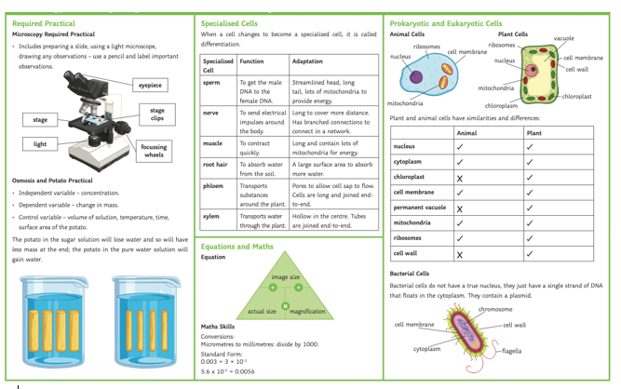

Slide 4
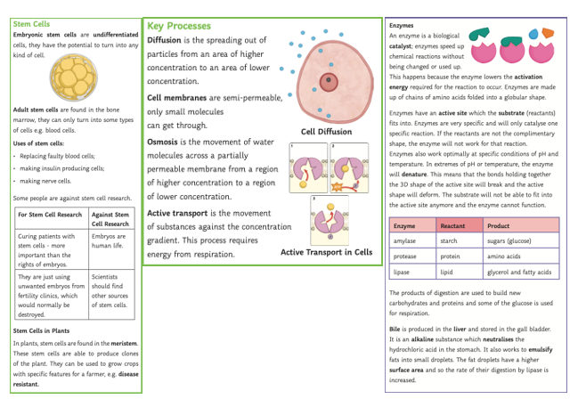

Slide 5
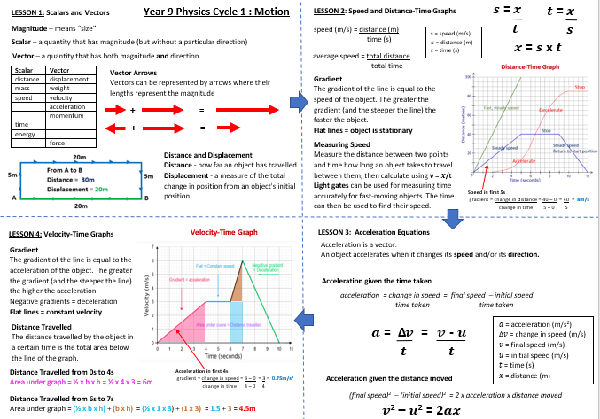

Slide 6
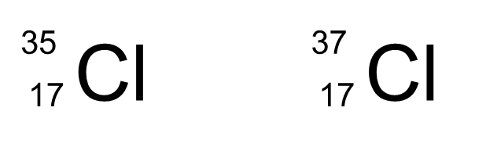
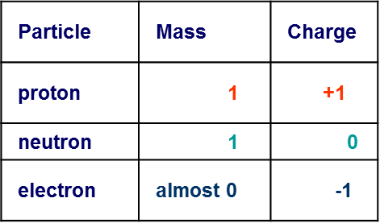
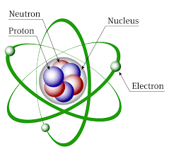
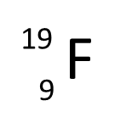
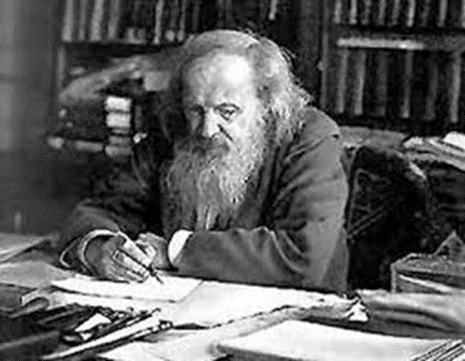
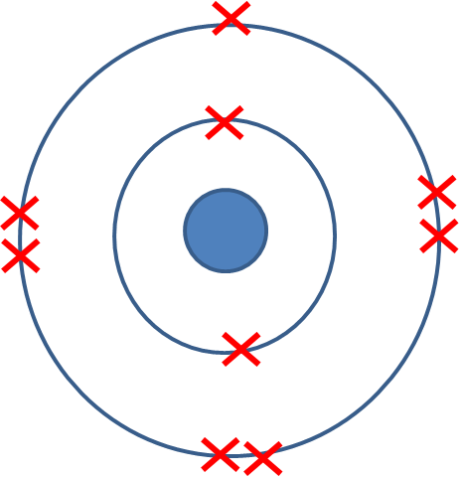
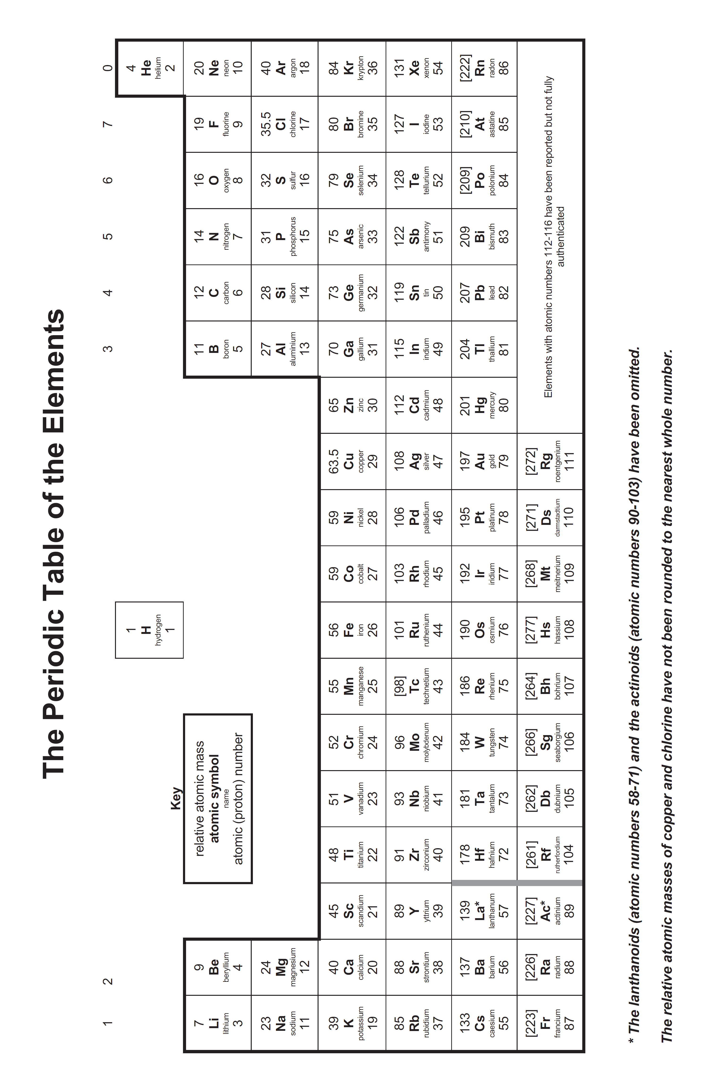
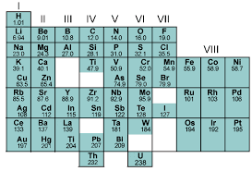
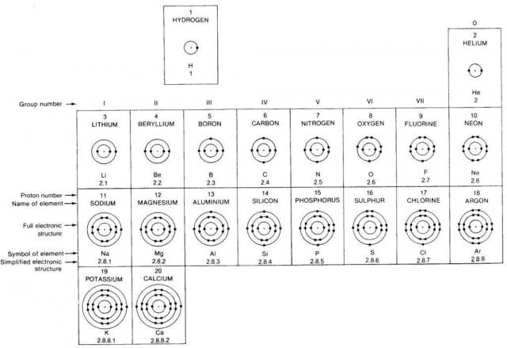
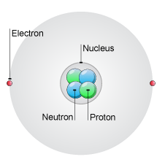
Y9: Cycle 2 - Atomic structure and the periodic table knowledge organiser
Lesson 1 Structure of the atom
Lesson 2 Atomic number and mass number
Lessons 3 & 4 Isotopes & Calculating RAM
Everything in the world is made up of tiny particles called atoms.
There are 92 different types of atom and different combinations of these atoms make all of the things that you see around you.
Scientists originally thought that atoms were tiny hard spheres that could not be broken down further (Daltons atomic theory).
We now know they are made of sub-atomic particles: Protons, Neutrons and Electrons
Different atoms have different numbers of protons, neutrons and electrons. The periodic table is arranged in order of increasing number of protons.
Information about the number of protons, neutrons and electrons can be found from the periodic table
An isotope is the same element that has a different mass
Atoms of isotopes have the same number of protons and electrons but different numbers of neutrons giving them different mass.
The Relative Atomic Mass (RAM) is the mass of an atom of an element relative to a Carbon-12 atom and taking into account the naturally occurring isotopes and their natural abundances
Protons neutrons and electrons have different mass and charge
Every element has a different proton number
If the proton number changes, the type of element changes!
Atoms are overall neutral charge
The number of protons = number of electrons in a neutral atom
Protons and neutrons are found in the nucleus
e.g. Chlorine has two isotopes
³⁵Cl and ³⁷Cl
If naturally occurring chlorine is 75% chlorine-35 and 25% chlorine 37 then the RAM can be calculated:
Electrons are found in shells
Lesson 7 Electron configuration
Lesson 6 The modern periodic table
Lesson 5 Mendeleev and the early periodic table
[2,7]
The modern periodic table is arranged according to increasing atomic number
Mendeleev had to reverse the order of some elements to make them fit their families
When Mendeleev wrote his table scientists knew about 40 different elements
They arranged these elements in order of increasing mass
Scientists who first did this found that the properties of elements repeated themselves every 8 elements.
Fluorine has 9 electrons
Mendeleev is famous because he left gaps in his periodic table for elements which had not been discovered. He predicted the properties of these elements. When they were found they fitted his predictions
Electrons are found in ‘shells’ around the nucleus
Each shells can only fit a certain number of electrons.
Shells are filled with the inside (lowest energy) ones first.
The first 3 shells can fit 2, 8, 18 electrons (best remembered 2,8,8)
You don’t have to do this in the modern periodic table
Columns of elements are called groups
Groups of elements have similar properties
Rows of elements are called periods
Lesson 7 Electron configuration and the periodic table
Elements in the same group have same number of electrons in the outer shell and have similar chemical properties
The structure of an atom
Elements in the period have the same number of shells with an extra electron added to the same shell as you move along.

Slide 9
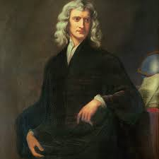
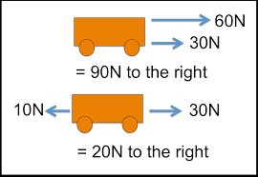
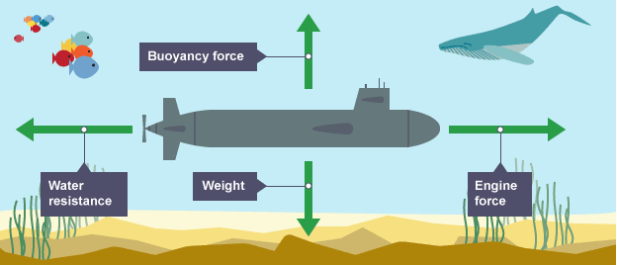
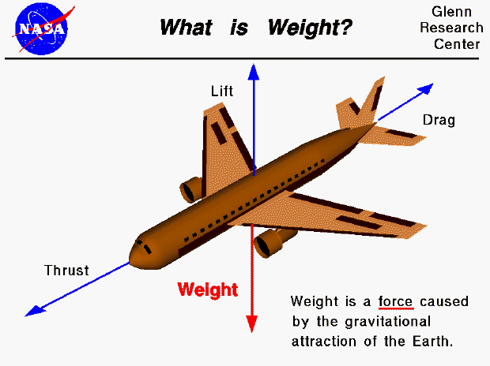
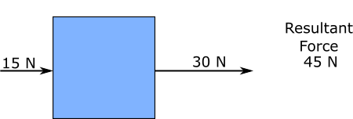
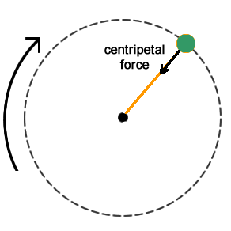
Forces : Year 9 : Cycle 2
Lesson 1: Resultant Forces
Lesson 2: Newton's 1st law
Newton's 1st law states that:
An object with zero resultant force will remain stationary or at constant velocity.
Force is a vector quantity, forces have size and direction.
The unit for force is the Newton, N.
So an object acted upon by only balanced forces will experience no change in either speed or direction .
a stationary object stays stationary
a moving object continues to move at the same velocity (at the same speed and in the same direction)
The size of the arrow represents the size of the force, the direction of the force is represented by the direction of the arrow,
If the size of the arrows are equal in size and opposite in direction then the resultant force is zero.
This submarines engine force and water resistance are balanced meaning it will neither speed up or slow down.
The weight and buoyancy forces are balanced so it will not move up or down and stay at the same depth.
The resultant force is the overall force acting on the object.
If the forces are acting in opposite directions they are subtracted.
If the forces are acting in the same direction they are added.
Lesson 4: Newton's 2nd law
Lesson 3: Mass and Weight
Newton's 2nd law states that:
The acceleration of an object is proportional to the resultant force acting upon it.
Weight is a force, it is the downward pull caused by the Earths gravitational field.
This object has a resultant force acting upon it and so will accelerate in the direction of the larger force.
How much it will accelerate also depends on the mass of the object.
Circular motion (Higher Only)
An object travelling in a circular path such as the earth orbiting the sun is constantly changing direction.
As a change in direction is a change in velocity then the object is by definition accelerating.
This acceleration is caused by an unbalanced force acting towards the centre of the circular path called the centripetal force.
Mass is a scalar quantity (size only, no direction) and refers to the amount of material an object is made out of.
Weight can be calculated using the equation:
3 kg
$Weight \left(N\right)=Mass\left(kg\right)×Gravitational Field Strenght(N/kg)$
$$W=m×g$$
On Earth g = 10N/kg
Acceleration = 45N $÷$ 3kg
Acceleration = 15m/s²
Newton's 2nd law is most often stated as an equation:
An apple has a mass of 0.2 kg. Calculate its weight on Earth .
$W=m×g W=0.2×10$ $W=20N$
$Force \left(N\right)=Mass\left(kg\right)×Acceleration (m/s2)$
$$F=m×a$$

Slide 10
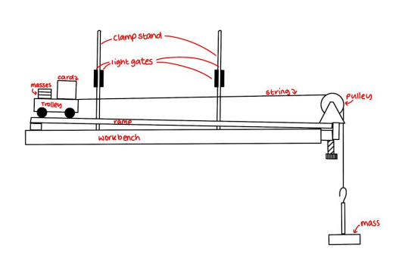
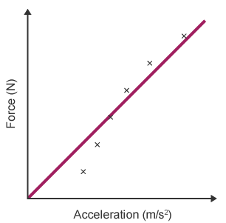
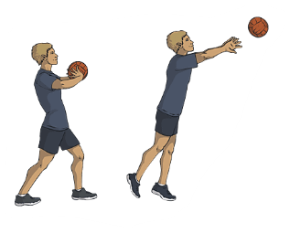
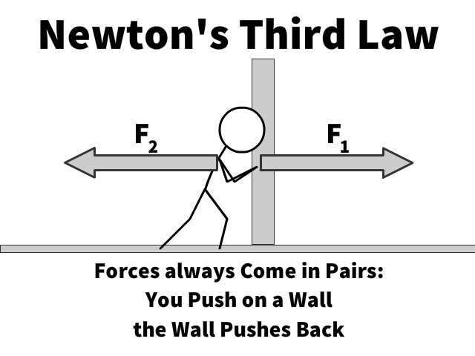
Forces : Year 9 : Cycle 2
Lesson 5: Investigating Acceleration
Method:
1. Set up the equipment as shown in the diagram below
2. Use the balance to measure the mass of the trolley (with no extra masses added)
3. Start with one 0.1kg (1N Force) mass hanging on the end of the string and no masses on the trolley
4. Release the trolley from rest and record the time it takes to travel between the light gates (which will be shown on the data logger) as well as the velocity of the trolley at each light gate (also on data logger)
5. Add one 0.1kg mass to the trolley and repeat
6. Continue adding masses to the trolley until all of the masses are used up (or a reasonable number have been used in order to get comprehensive results), recording the time taken and the velocity at both gates each time
7. Calculate the acceleration for each recorded value using $a=\frac{v−u}{t}$
8. Plot a graph of acceleration against force, which should give a straight line, directly proportional relationship.
Aim :The aim of this investigation is to find the effect of changing the force on the acceleration of the trolley.
Key Facts
● Friction is reduced by raising the ramp slightly so that, when pushed, the trolley will roll to the end of the ramp without stopping, this can also be achieved by using an air track.
● You must also measure the length of the card attached to the trolley and input that into the data logger so that it can calculate the velocity of the trolley as it passes through the light gates.
● The total mass of the system must be kept the same so masses are transferred from the trolley to the pulley.
● Light gates are used so that human reaction time does not affect the accuracy of the results.
Lesson 7: Momentum (Higher Only)
Lesson 6: Newton's 3rd law
Momentum is a vector quantity and a property of all moving objects, it depends on the objects:
Mass (Larger mass = Larger momentum)
Velocity (Larger velocity = Larger momentum)
Newton's 3rd law states that:
When two objects interact each exerts a force on the other which is equal in size and opposite in direction
Newton's 3rd law is often called the action-reaction law.
The forces are sometimes called interaction pairs, the forces must also:
act on two different objects
are of the same type (e.g. both contact forces)
F_{Boy}
Collisions
During any collision between two objects, momentum is the same before and after the collision. This is called the conservation of momentum.
In this worked example 2 cars crash and become stuck together.
At what velocity will they move off after the collision?
$Momentum \left(kgm/s\right)=Mass\left(kg\right)×velocity (m/s)$
$$ρ=m×v$$
F_{Ball}
Before Collision
After Collision
S$ince momentum is conserved$, momentum after is also = $6 kgm/s$
$$v= \frac{ρ}{m}= \frac{6}{10}$$
$$v=0.6m/s$$
In this example the boy pushes the ball, the ball pushes back on the boy, the force is equal in size and opposite in direction.
The ball moves but the boy doesn’t because the mass of the boy is much larger than the mass of the ball.
$$Total momentum before=$$
(Mass $×$Velocity) + (Mass $×$Velocity)
$$\left(3 ×2\right)+\left(8×0\right)=6 kgm/s$$
Objects in equilibrium do not move

Slide 11
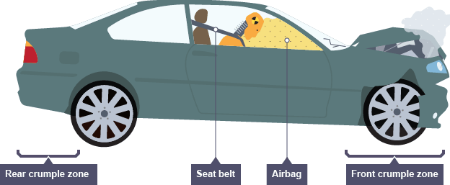
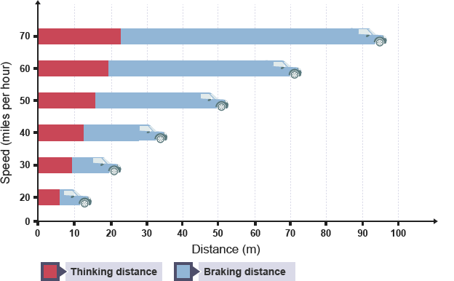
Forces : Year 9 : Cycle 2
Lesson 8: Changes in Momentum (Higher Only)
Lesson 9: Stopping Distances
When a resultant force acts on an object that is moving, or able to move, there is a change in momentum.
This force can be found by combining the equation for Newton's 2nd law and the equation used to calculate acceleration:
In an emergency, a driver must bring their vehicle to a stop in the shortest distance possible:
stopping distance = thinking distance + braking distance
Thinking distance is the distance a vehicle travels in the time it takes for the driver to apply the brakes after realising they need to stop.
Braking distance is the distance a vehicle travels in the time after the driver has applied the brake.
$a= \frac{(v −u)}{t}$
$$F=m×a$$
Thinking distance
Reaction times vary from person to person, but are typically 0.2 s to 0.9 s. A driver’s reaction time can be affected by:
Tiredness
Drugs
Alcohol
Distractions
Longer reaction times increase thinking distance.
Braking distance
The braking distance of a vehicle can be increased by:
poor road and weather conditions, such as gravel, or wet or icy roads - less friction between tyres and the road
poor vehicle conditions, such as worn brakes or worn tyres - less friction between brakes and wheels
more mass in the vehicle (extra passengers for example) - the braking friction has to work for a greater distance to remove the larger kinetic energy
$$F= \frac{(mv −mu)}{t}$$
force (F) is measured in Newton's (N)
change in momentum (mv - mu) is measured in kilogram metres per second (kg m/s)
time taken (t) is measured in seconds (s)
Lesson 11: Crash Hazards
Lesson 10: Braking distance and Energy (Triple only)
During a crash large decelerations happen in a very small amount of time.
The force exerted on the car and the people inside becomes larger the smaller this time becomes.
Cars have several safety features which are designed to increase the time of the impact and so decrease the forces involved.
During braking, the kinetic energy of the moving vehicle is transferred by a force to other forms, mostly thermal energy in the brakes and the surroundings.
The energy transferred by the force is called work done, and is calculated by the equation:
$Work Done \left(J\right)=Force \left(N\right)×Distance Travelled (m)$
$$E=F×d$$
Since the car has kinetic energy given by:
$Kinetic Energy \left(J\right)=\frac{1}{2}×Mass \left(kg\right)×Velocity2 (m/s)$
$$E =\frac{1}{2}×m×v2$$
Distance is proportional to velocity squared.
If the cars speed doubles then stopping distance increases 4 times (2²).
If the cars speed triples then stopping distance increases 9 times (3²).

Slide 12
Y9: Cycle 3: Atoms to ions knowledge organiser
Lesson 1 Structure of the atom Review
Lesson 1 Structure of the Atom Review
Lesson 2 Periodic Table Review
Everything in the world is made up of tiny particles called atoms.
There are 92 different types of atom and different combinations of these atoms make all of the things that you see around you.
Scientists originally thought that atoms were tiny hard spheres that could not be broken down further (Daltons atomic theory).
We now know they are made of sub-atomic particles: Protons, Neutrons and Electrons
Different atoms have different numbers of protons, neutrons and electrons. The periodic table is arranged in order of increasing number of protons.
Information about the number of protons, neutrons and electrons can be found from the periodic table
When Mendeleev wrote his table scientists knew about 40 different elements
They arranged these elements in order of increasing mass
Every element has a different proton number
If the proton number changes, the type of element changes!
Atoms are overall neutral charge
The number of protons = number of electrons in a neutral atom
Scientists who first did this found that the properties of elements repeated themselves every 8 elements.
Protons neutrons and electrons have different mass and charge
Mendeleev is famous because he left gaps in his periodic table for elements which had not been discovered. He predicted the properties of these elements. When they were found they fitted his predictions
Protons and neutrons are found in the nucleus
Electrons are found in shells
Lesson 2 Periodic Table Review
Lesson 2 Periodic Table Review
[2,7]
Lesson 2 Periodic Table Review
The modern periodic table is arranged according to increasing atomic number
Mendeleev had to reverse the order of some elements to make them fit their families
Elements in the same group have same number of electrons in the outer shell and have similar chemical properties
Fluorine has 9 electrons
Electrons are found in ‘shells’ around the nucleus
Each shells can only fit a certain number of electrons.
Shells are filled with the inside (lowest energy) ones first.
The first 3 shells can fit 2, 8, 18 electrons (best remembered 2,8,8)
You don’t have to do this in the modern periodic table
Columns of elements are called groups
Groups of elements have similar properties
Rows of elements are called periods
Elements in the period have the same number of shells with an extra electron added to the same shell as you move along.
Lessons 3 and 4 Ionic Bonding
Atoms are more stable with a full outer shell of electrons and they will lose or gain electrons to achieve this.
Atoms that lose electrons (metals) gain a positive charge. Atoms that gain electrons (non-metals) gain a negative charge. An ion is an atom with a charge.
For metals , Groups 1, 2 & 3 Ionic Charge = Group Number with a + sign
For non-metals , Groups 5, 6 & 7Ionic Charge = Group Number – 8; eg group 5, 5-8 = -3
Ionic bonds form between metals and non-metals.
Metals have extra electrons and they lose them to form positive ions.
Non- metals have electron gaps and they gain electrons to form negative ions.
In an ionic bond the metal ‘gives’ its electrons to the non-metals to form positive and negative ions
You need to be able to calculate the number of protons, neutrons and electrons in different ions and draw electron structure of ions showing their charge outside of brackets.

Slide 13
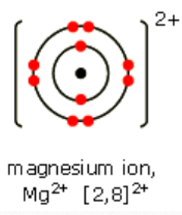
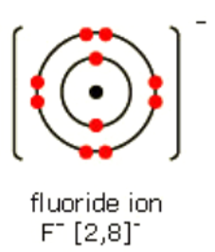
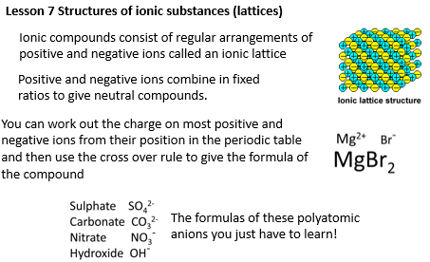
Lessons 3 and 4 Ionic Bonding
Lessons 5 and 6 Writing Formulae
The number of positive(+) charges must equal the number of negative charges(-) when an ionic compound is made.
One magnesium atom gives two fluorine atoms 1 electron each.
The formula of the compound, Magnesium Fluoride, shows the number of ions of each.
Formula = MgF₂
The ionic compound made is called sodium chloride

Slide 14
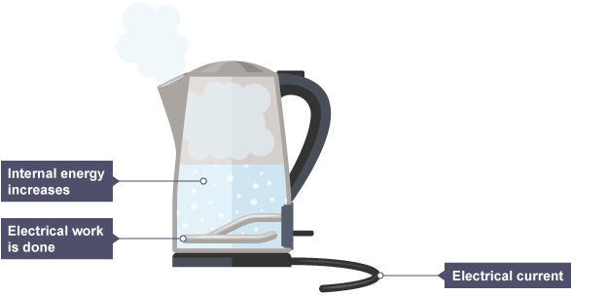
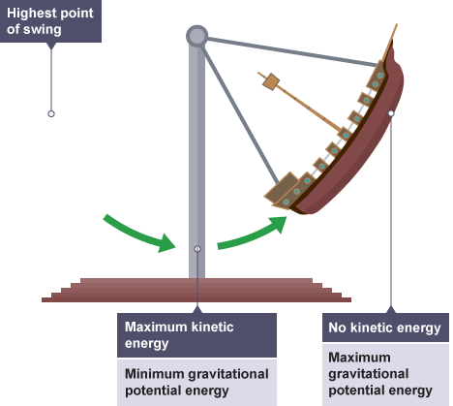
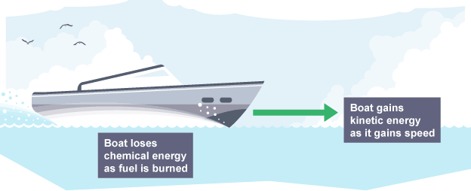
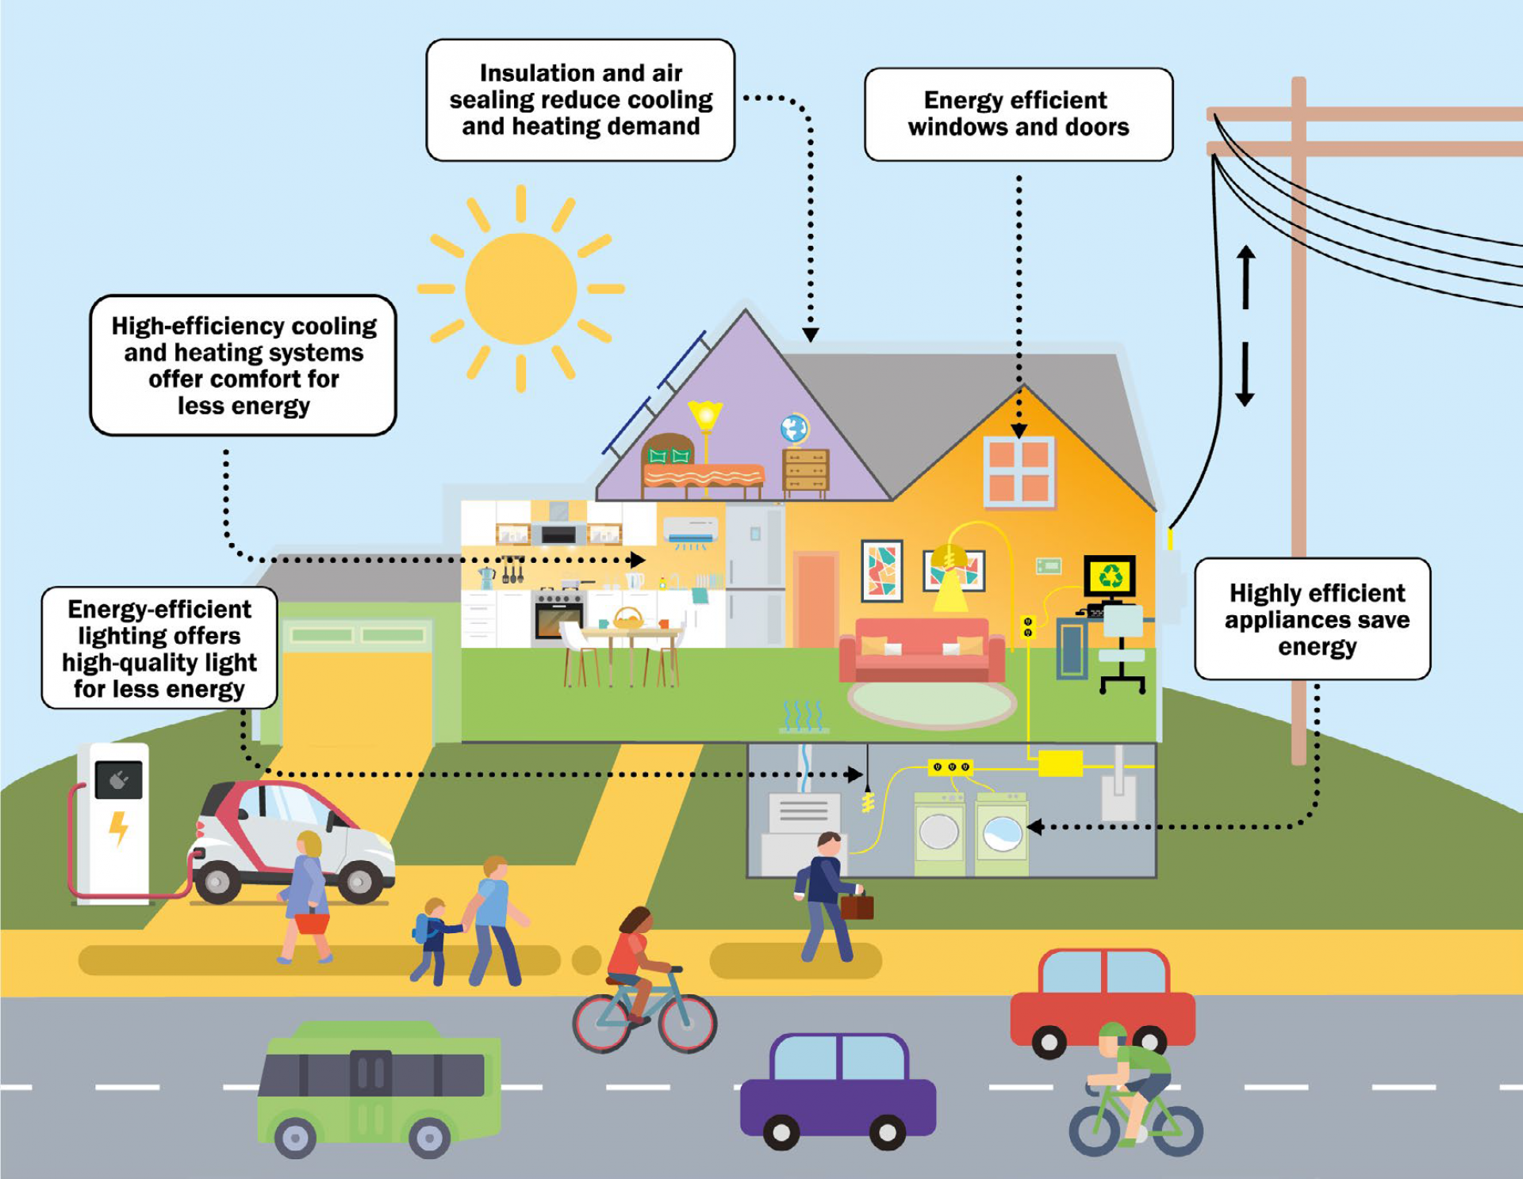
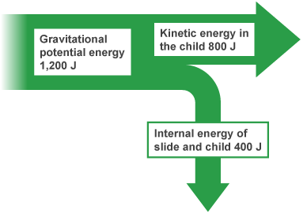
Energy Transfers: Year 9 : Cycle 3
Lesson 1: Energy Stores and Transfers
Energy Transfers
mechanical work - a force moving an object through a distance
electrical work - charges moving due to a potential difference
heating - due to temperature difference caused electrically or by chemical reaction
radiation - energy transferred as a wave, e.g. light and infrared - the Sun emits light radiation and infrared radiation
Energy store | Description | Examples
Magnetic | The energy stored when repelling poles have been pushed closer together or when attracting poles have been pulled further apart. | Fridge magnets, compasses, maglev trains which use magnetic levitation.
Internal (thermal) | The total kinetic and potential energy of the particles in an object, in most cases this is the vibrations – also known as the kinetic energy – of particles. In hotter objects, the particles have more internal energy and vibrate faster. | Human bodies, hot coffees, stoves or hobs. Ice particles vibrate slower, but still have energy.
Chemical | The energy stored in chemical bonds, such as those between molecules. | Foods, muscles, batteries.
Kinetic | The energy of a moving object. | Runners, buses, comets.
Electrostatic | The energy stored when repelling charges have been moved closer together or when attracting charges have been pulled further apart. | Thunderclouds, Van De Graaff generators.
Elastic potential | The energy stored when an object is stretched or squashed. | Drawn catapults, compressed springs, inflated balloons.
Gravitational potential | The energy of an object at height. | Aeroplanes, kites, mugs on a table.
Nuclear | The energy stored in the nucleus of an atom. | Uranium nuclear power, nuclear reactors.
Lesson 2: Energy Efficiency
No system is perfect. Whenever there is a change in a system, energy is transferred and some of that energy is dissipated (wasted energy).
A very efficient device will waste very little of its input energy.
A very inefficient device will waste most of its input energy.
The conservation of energy
Energy can be transferred usefully, stored or dissipated, but it cannot be created or destroyed.
Sankey Diagrams
The width of the arrow is drawn to scale to show the amount of energy transferred, Total energy in = total energy out.
$$Efficiency =useful energy÷total energy supplied$$
It is not possible to have an efficiency of greater than 1 or an efficiency percentage greater than 100%.
Mechanical devices can be made more efficient through lubrication to reduce the friction
Insulation can be used to reduce energy dissipated thermally.
Energy efficient machines and homes waste less energy, this can save money and reduce other harmful impacts on the environment .

Slide 15
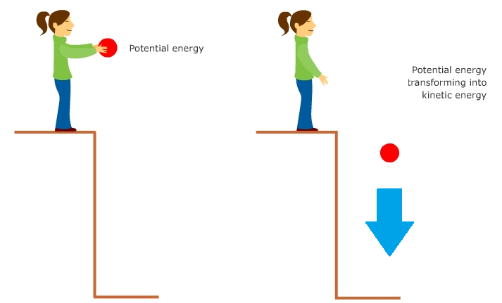
Lesson 3: Energy Stores – Gravitational Potential and Kinetic Energy
Gravitational Potential Energy (GPE)
GPE is the energy stored by an object lifted up against the force of gravity. The amount of energy stored depends on the mass of the object and the height it is raised to.
Energy Calculations
The amount of gravitational potential energy stored by an object at height can be calculated using the equation:
change in gravitational potential energy (J) = mass (kg) x gravitational field strength (N/kg) x change in vertical height (m)
$$∆GPE=m × g × ∆h$$
The amount of kinetic energy of a moving object can be calculated using the equation:
kinetic energy (J) = ½ x mass (kg) x velocity² (m/s)
$$KE=\frac{1}{2}× m ×v2$$
Kinetic Energy (KE)
KE is the energy stored by an object that is moving. The amount of energy stored depends on the mass of the object and the velocity it is moving at.
Lesson 4: Keeping Warm – Core Practical
^{Method:}
Set up the experiment as shown in the diagram
Boil the kettle and pour water into each of the beakers, ensuring that they all have the same volume, and cover each beaker with a lid
Record the initial temperature of each beaker and start the stopwatch.
Record the temperature of each beaker at regular time intervals (e.g. example, every two minutes for a total of 20 minutes or until the water has reached room temperature).
^{Improving Accuracy}
Place the cans on a heatproof mat to reduce the thermal energy lost to the table surface by conduction.
Place a lid over the cans to reduce the thermal energy lost to the air by evaporation.
Complete the experiments with different insulators simultaneously so that a change in the temperature of the laboratory does not affect the results.
Place the measuring cylinder on a flat, level surface and read it from eye level to get an accurate reading of the volume of water.
^{Equipment:}
^{Beakers (at least four)}
^{Kettle}
^{1 thermometer for each beaker}
Different-coloured materials to clad each beaker.
A lid for each beaker (with a slit for the thermometer).
^{Stopwatch}
Independent Variable: Insulating material.
Dependent Variable: The temperature decrease of water after a given time.
^{Control Variables:}
^{The volume of water used.}
The initial temperature of the water.
The time taken between measurements.
Thickness of the insulating material.

