Slide 1
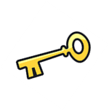
Year 9 Cycle One Knowledge Organiser
Judaism – Key information
Judaism began approximately 4000 years ago.
The founder of Judaism was Abraham.
A key prophet of Judaism was Moses.
Followers of Judaism are known as Jews.
There are different types of Jews, the two main types being Orthodox and Reform.
A lot of Christian beliefs are rooted in the religion of Judaism.
Jewish beliefs about God
Jews share many of the same beliefs as Catholics about God. The four key beliefs to remember, that are all linked to the Torah are:
God as one – Jews only believe in one God who is not subdivided into different parts. The Shema prayer (Jewish declaration of faith) states ‘Hear O Israel, the Lord our God, the Lord is one’
God as Creator – Jews believe that God is the creator of everything. The first line of the Torah in Genesis 1 states ‘In the beginning God created the heavens and the earth’.
God as Law Giver – Jews believe that God has given important rules for his people to follow. The most famous example is when he gave Moses the Ten Commandments.
God as Judge – Genesis states that God is ‘judge of all the world’ and for Jews this is important because it means he is judging everyone on their actions.
Key Concept | Definition
Synagogue | A house of assembly; building for Jewish public prayer, study and assembly.
Shekinhah | The place where God’s presence rests and can be felt.
Shabbat | Is the day of spiritual renewal and rest. Beginning at sunset on Friday and closing at nightfall Saturday.
Kosher | Means ‘fit’ or ‘proper’. Foods that are permitted to be eaten according to Leviticus 11. It is also used to refer to the purity of rituals such as Torah scrolls.
Torah | The five books of Moses (Genesis, Exodus, Leviticus, Numbers and Deuteronomy). Regarded as the holiest books of the Tenakh
Mitzvot | The term has a mix of meanings. It is often used to refer to duties (such as the 613 in the Torah) and good deeds.
Messiah | The anointed one who Jews believe will bring in a new era or age for humankind. This will include rebuilding the Temple and bringing in an age of universal peace.
Covenant | A promise or agreement between two parties. Covenants were made between God with Noah, Abraham and Moses.
The Shekinhah
The word Shekinhah means ‘to dwell or settle’ and it is used to describe the Jewish belief that God’s presence has been felt in the world. Jews believe that the Shekinhah (God’s presence) has been felt in the following places:
The Holy Temple
Mt Sinai – when God appeared to Moses.
The holy city of Jerusalem.
The synagogue.
Jews believe that they can experience the Shekinhah in study, worship and prayer.
Jewish expectations of the Messiah
The Messiah means anointed one.
Orthodox Jews believe God will send someone who will achieve the Messianic Age by being a descendent of King David, a military leader and a righteous judge.
Reform Jews do not still believe that God will send one person to do these things, instead it is the duty of all Jews to try and achieve the Messianic Age.

Slide 2
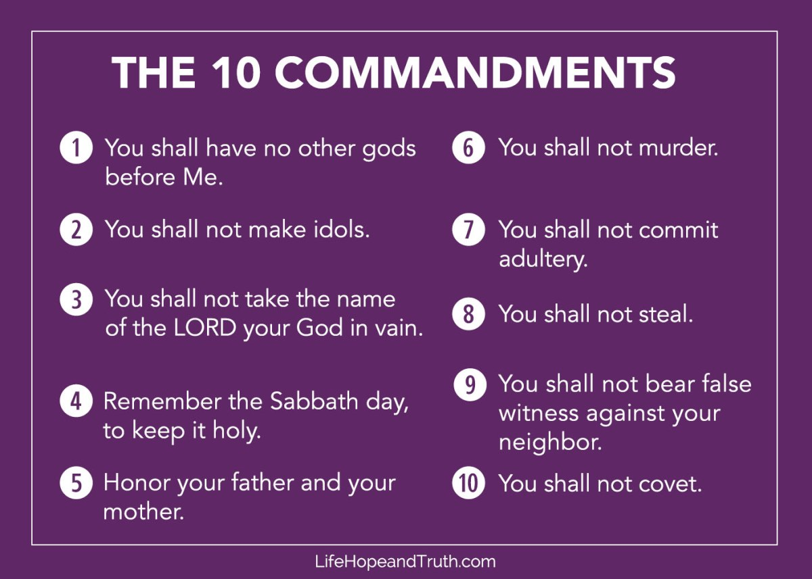
Year 9 Cycle One Knowledge Organiser
The Abrahamic Covenant
God asked Abraham to:
Leave his home town and go to Canaan which would be the Promised Land.
To establish the religion of Judaism – to be a Father of a great nation.
God promised Abraham in return:
A son – Abraham and his wife had not been able to have children.
To bless him and his family.
An everlasting covenant.
The sign of the covenant, still observed by Jews today is the rite of circumcision as performed during the ritual of Brit Milah.
The Mosaic Covenant
Moses is considered to be the most important prophet as God revealed the Torah to him on Mt Sinai.
The covenant between God and Moses involved God giving Moses the Ten Commandments to help his chosen people maintain a positive relationship with God and each other. God gave Moses the Ten Commandments and in return he expected his people to follow them.
The Ten Commandments (Decalogue) are very important to Jews because they are the laws given by God to Moses.
The first four focus Jews on their relationship with God.
The remaining six focus Jews on their relationship with other people.
Jews ‘Observe the Sabbath and keep it holy’ as a sign of still following the Mosaic covenant.
The Mitzvot
Jews not only follow the Ten Commandments but follow a wider set of duties known as the Mitzvot.
There are 613 mitzvot (duties) in the Torah although some can no longer be kept as they refer to practices in the Temple which is now destroyed.
The mitzvot outline what Jews should and should not do in daily life to maintain a good relationship with God and other people.
Jews do believe that they are born with free will and therefore choose whether to follow the mitzvot or not, they do recognise that the Mitzvot help Jews live a life the way God would want them to.
Pikuach Nefesh/Sanctity of Life
Pikuach Nefesh is the duty (mitzvah) to save life wherever possible.
Jews regard this as arguably the most important duty because life has been given as a gift from God and all humans should do what they can to protect it.
Jews might break other mitzvot if it is needed to save life, for example a doctor might be needed to work on Shabbat in order to save life.
Jewish beliefs about life after death
The afterlife is often called Olam Ha-Ba (the world to come). There are no direct teachings in the Torah about life after death but most Jews have some sort of belief in life after death.
As Jews believe God is a judge, many believe this may be linked to life after death. Many Jews believe in:
1 – Gan Eden – Spiritual reward after death.
2. – Gehenna – Spiritual punishment after death

Slide 3
Year 9 Cycle 1: Website work – week 3
Copy out the list of key vocabulary and definitions.
What is the meaning of the word covenant?
What did God ask Abraham? What did God promise in return?
What was the key feature of God’s covenant with Moses?
Write out the Ten Commandments. Explain why they are important for Jews.

